Slide 1
Writing Academic Research

Slide 2

Writing Academic Research
Rabiah Ahmad , PhD
Haslinda Musa, PhD

Slide 3
Contents
Introduction
Type of Research Publication
(article proceeding, article journal, book chapter, monograph, book)
Paid vs Unpaid Journal
Winning Citation
Rejection
Workshop…

Slide 4





Saya, Mereka dan Dunia Penyelidikan
Ice Breaking

Slide 5
CRITERIA IN RANKINGS : MyRA^{R}
MyRA® | I | II | QS WUR |  | QS Asia |  | THE |  | ARWU
Quantity & Quality of Researchers | 25% | 15% | Academic reputation | 40% | Academic reputation | 30% | Industry Income – innovation | 2.5% | Quality of Education - Alumni of an institution winning Nobel Prizes and Fields Medals | 10%
Quantity & Quality of Research | 30% | 35% | Student-to-faculty ratio | 20% | Student-to-faculty ratio | 20% | International diversity | 5% | Quality of Faculty -Staff of an institution winning Nobel Prizes and Fields Medals; Highly cited researchers in 21 broad subject categories | 40%
Quantity of Postgraduate | 10% | 10% | Citations per faculty | 20% | Citations per paper | 15% | Teaching – the learning environment | 30%
Quality of Postgraduate | 5% |  | Employer reputation | 10% | Employer reputation | 10% | Research – volume, income and reputation | 30% | Research Output - Papers published in Nature and Science*; Papers indexed in Science Citation Index-expanded and Social Science Citation Index | 40%
Innovation | 10% | 15% | International faculty ratio | 5% | International faculty ratio | 2.5% | Citations – research influence | 32.5%
Professional Services & Gifts | 7% | 10% | International student ratio | 5% | International student ratio | 2.5% |  |  | Per Capita Performance - Per capita academic performance of an institution | 10%
Networking and Linkages | 8% | 12% |  |  | Inbound exchange students ratio | 2.5%
Support Facilities | 5% | 3% |  |  | outbound exchange students ratio | 2.5%
 |  |  |  |  | Papers per faculty | 15%
Total | 100% | 100% |  | 100% |  | 100% |  | 100% |  | 100%
MyRA aligns to the ranking systems

Slide 6
PENYELIDIKAN DAN INOVASI DALAM PENGAJARAN DAN PEMBELAJARAN
Penyelidikan dalam pendidikan (konteks GURU) merupakan penyokong utama dalam meningkatkan kualiti pendidikan dan pembangunan potensi intelek, rohani, emosi dan jasmani pelajar serta membantu menyelesaikan masalah yang dihadapi di dalam dan luar kotak pengajaran dan pembelajaran

Slide 7
PENYELIDIKAN DAN INOVASI DALAM PENGAJARAN DAN PEMBELAJARAN
Dalam konteks pendidikan di Malaysia, usaha untuk mencapai mutu dan kecemerlangan pendidikan selaras Falsafah Pendidikan Negara, Rukun Negara dan Wawasan 2020 dapat dilakukan dengan lebih efektif lagi sekiranya guru dan pengurus pendidikan mengamalkan ‘research thinking and orientation’ dan ‘research-based decision making’ dalam tugas harian mereka (Mahpor, 1997)

Slide 8
PEMBUDAYAAN
Penyelidikan &Inovasi
Ciri-ciri yang dinyatakan di dalam Al-Quran untuk menjana modal insan yang berkualiti:
  menguasai ilmu,
  berfikiran luhur,
  memiliki akhlak tinggi,
  bertoleransi,
  mempunyai daya saing
  (Mustafa Kamal et. al 2010)

Slide 9
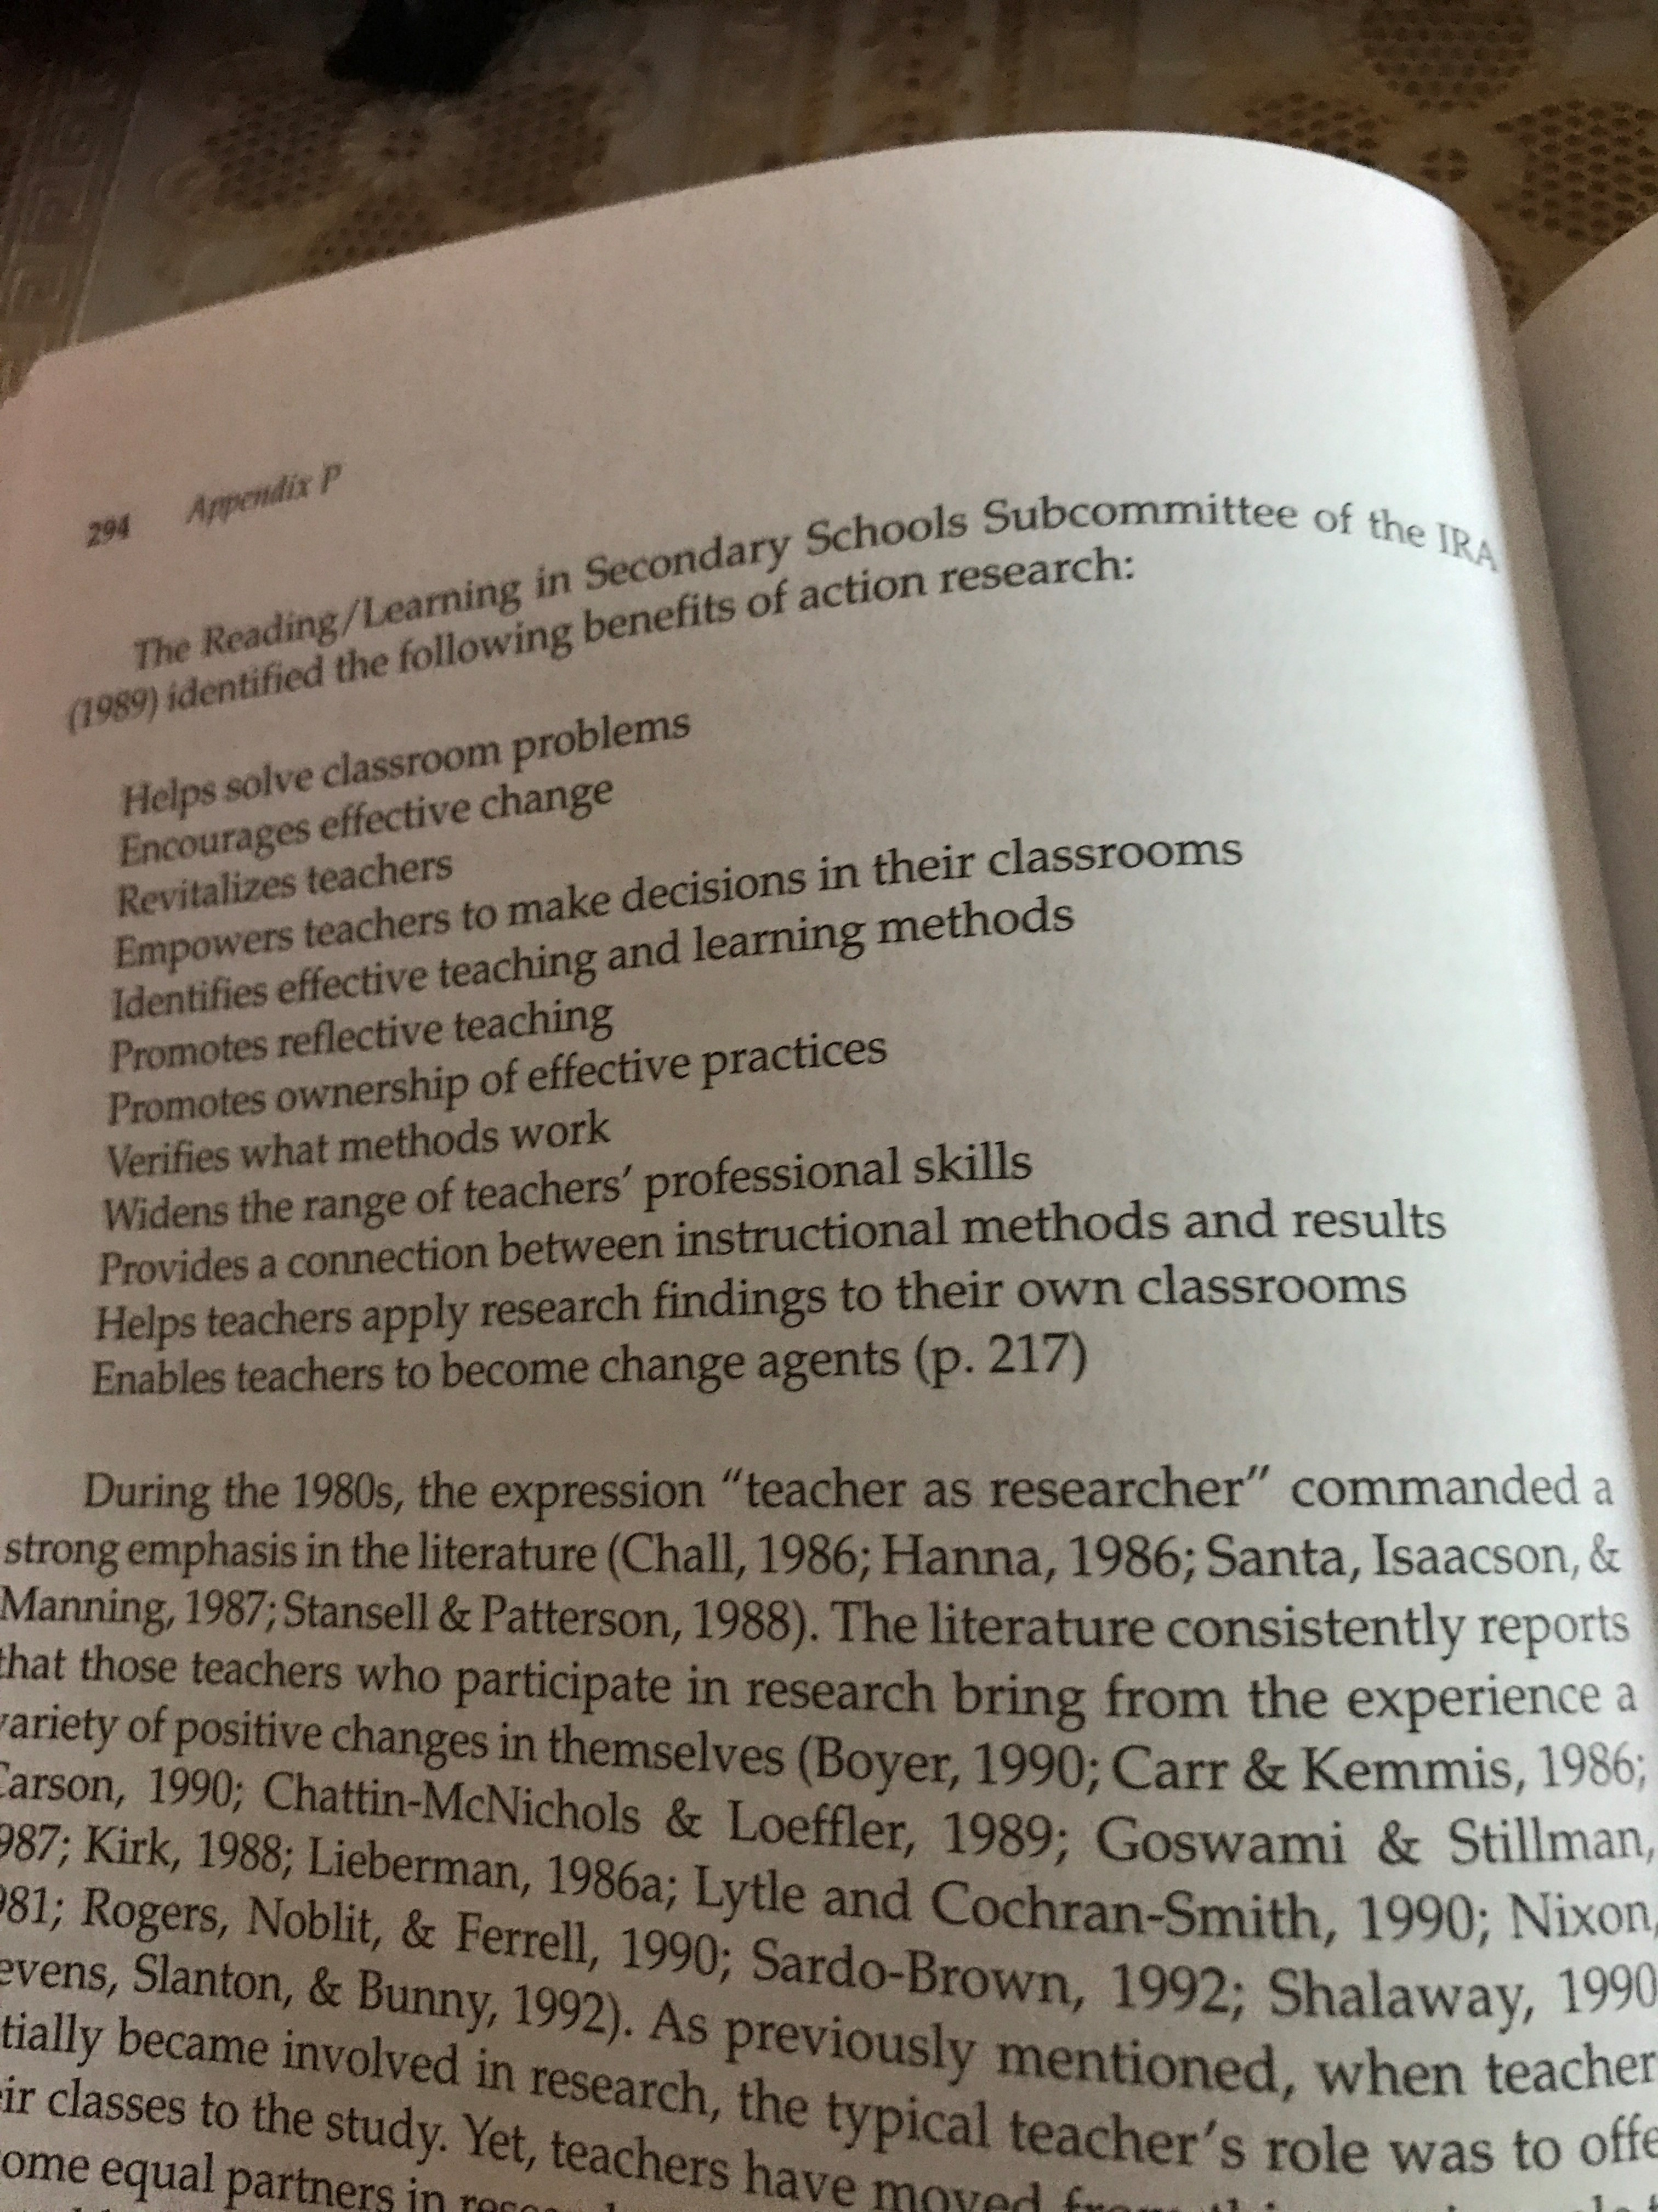

Slide 10


RESEARCHER AND SCHOLAR
Research Area and Scope
PhD vs Doctorate of Engineering,
MPHil, MEng, MSc
Postgraduate Program vs Research Project
Applied, Fundamental, Contract, Services
Current Demand and niche …

Slide 11

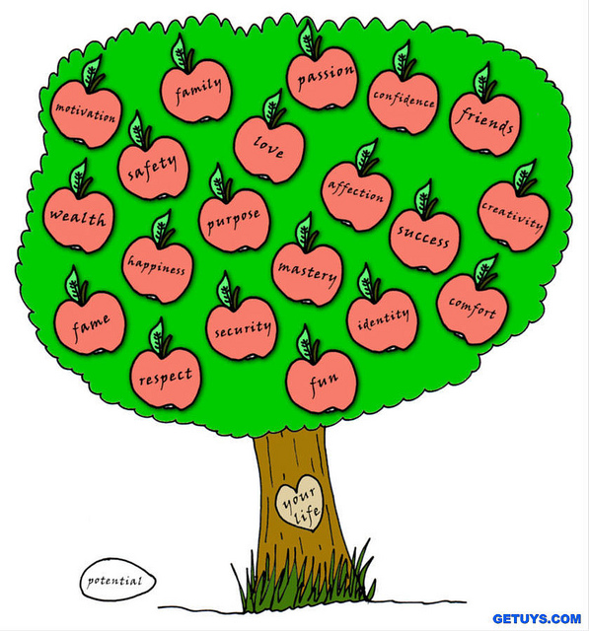


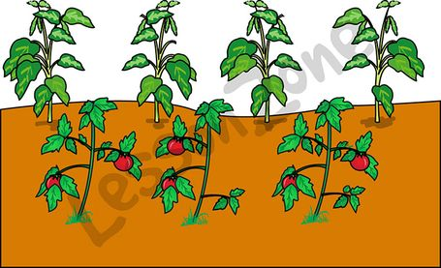
WE

Slide 12
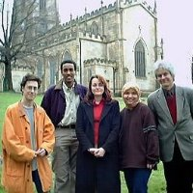
Career and Publication
SPM 1991
Diploma CS 1995
Bachelor CS 1997
UTM
MSc
London
Info Security
1998
PhD
Sheffield
2004
Tutor UTM, 1997
Proceeding
Pensyarah
1998
Proceeding
Local Journal
Pensyarah Kanan 2006
Citation
High impact
Prof Madya
UTeM 2010
High Impact
Citation
Editorial
Professor
UTeM
2015
Book
Invited
Chief Editor

Slide 13
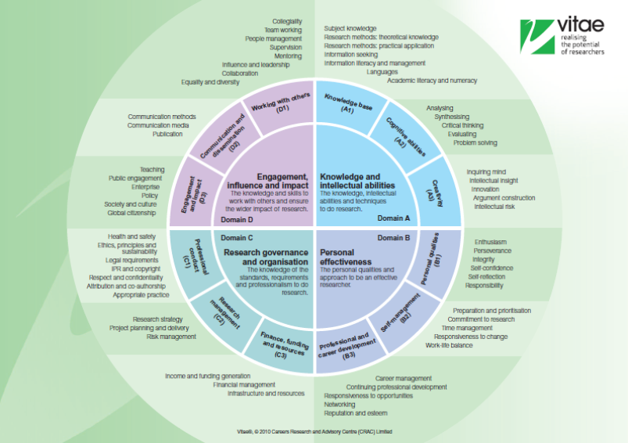

Slide 14
Winning Citation
Type of work
Target
Google scholar or Scopus

Slide 15
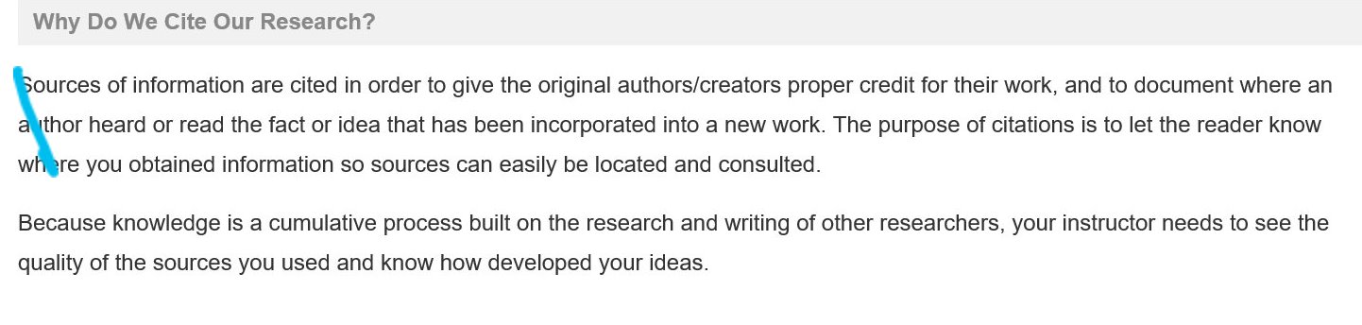
Citation and Me
(MIT Libraries)

Slide 16
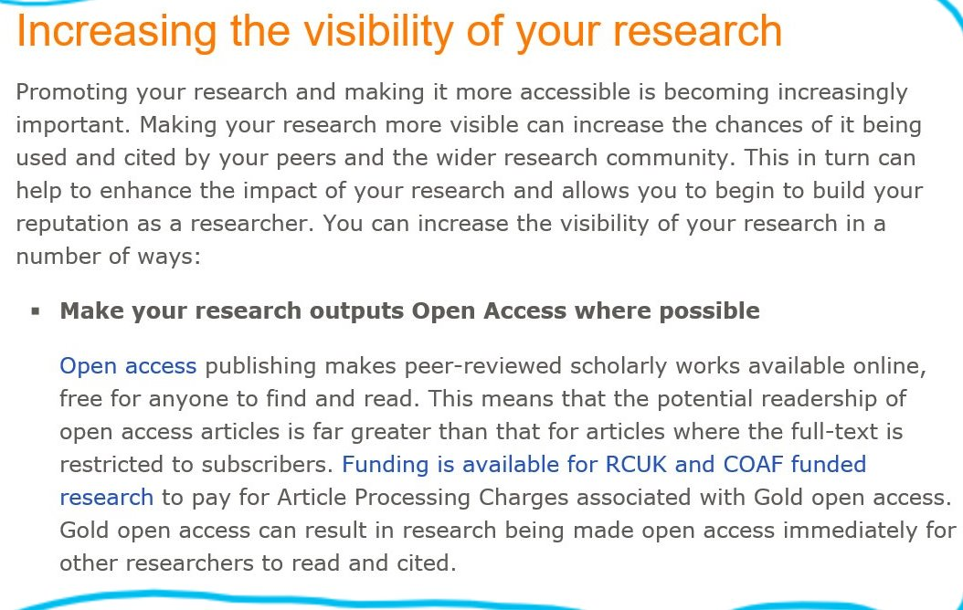

Slide 17
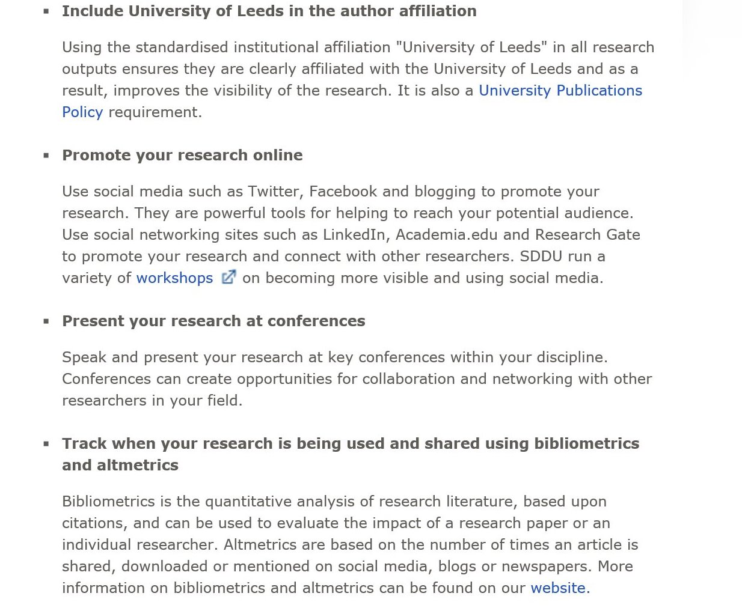

Slide 18
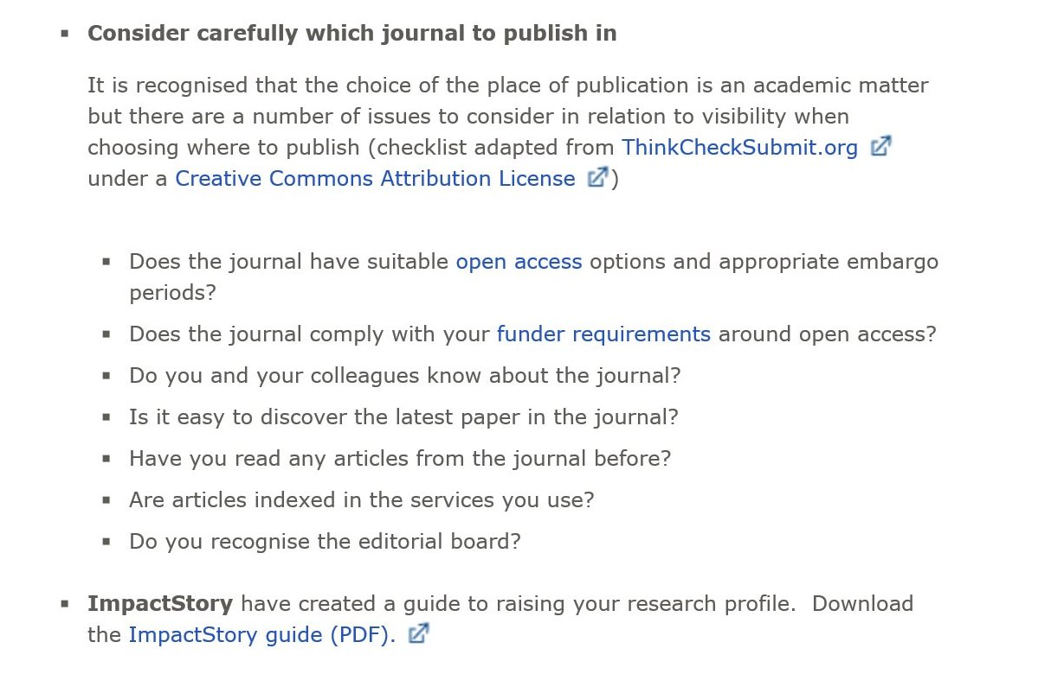

Slide 19
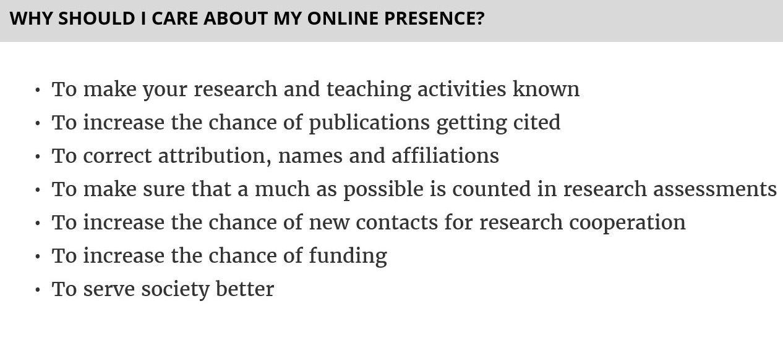
Research Visibility

Slide 20
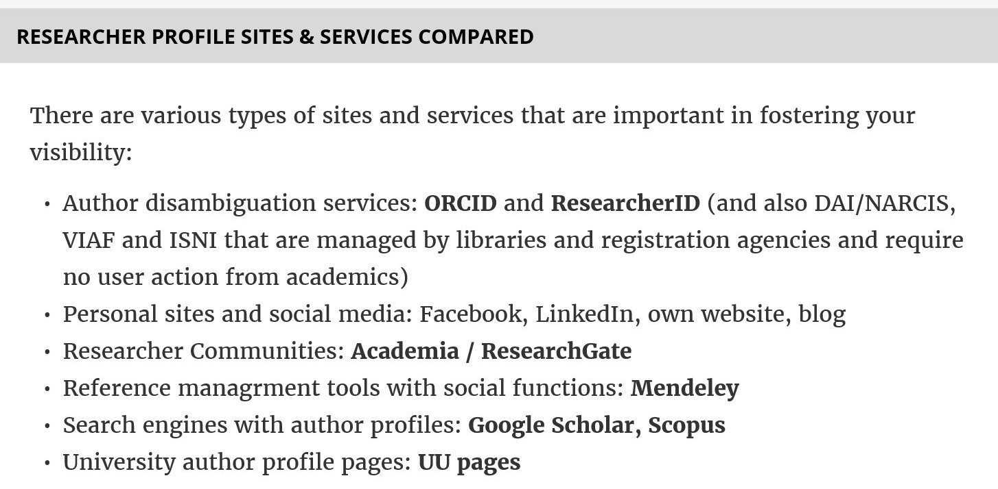
Research Visibility

Slide 21
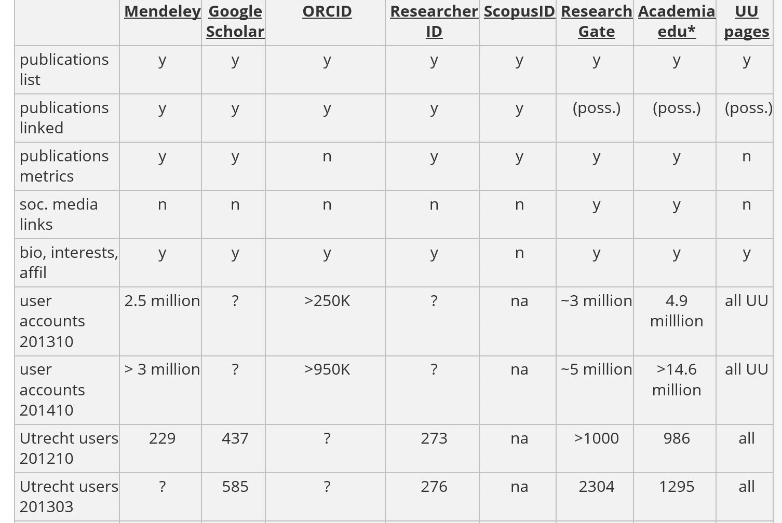

Slide 22

What, Where & When to start..
Early research
Experiment
Analysis
Conclusion

Slide 24
Publication as our Marks of Merit

Slide 25
WHY PUBLISH

Slide 26
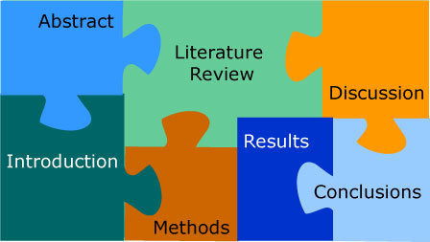
Good Proposal, Good Research, Good Thesis, Good Impact & Reputation

Slide 27
Where to publish..?
Why conference
Why journal
Book Chapter ?
Monograph…
Book

Slide 29
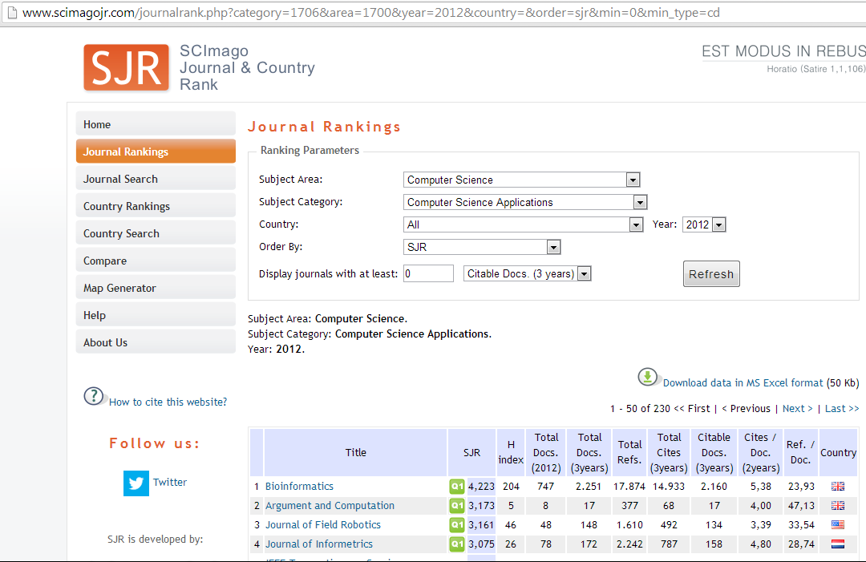
Scopus - evaluated by SciMago Journal Rank (SJR)*
*http://www.scimagojr.com/journalrank.php
(developed from the Google PageRank algorithm)

Slide 30
Scopus - evaluated by SciMago Journal Rank (SJR)*
Rank your journal..
  http://www.scimagojr.com/journalrank.php?category=1710&area=1700&page=5&total_size=819
*http://www.scimagojr.com/journalrank.php
(developed from the Google PageRank algorithm)

Slide 31
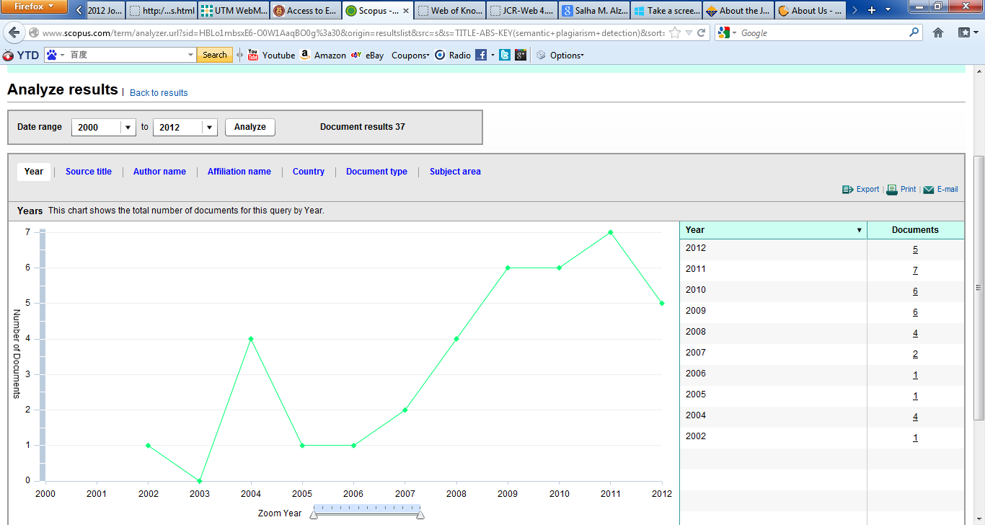
Analyze trend
Going up?

Slide 32
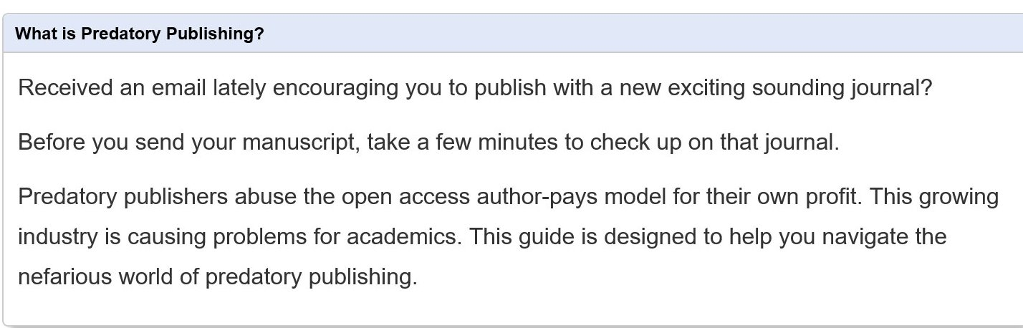
Predatory Publisher

Slide 33
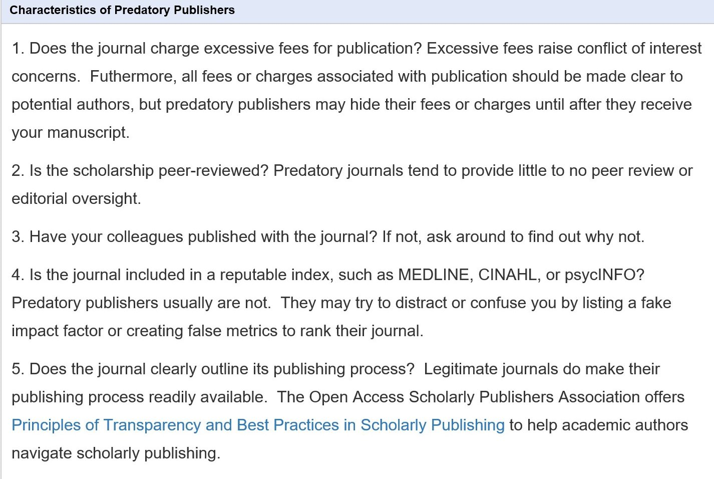
Predatory Publisher

Slide 34
Planning to Write

Slide 35
Rejection

Slide 40
Plagiarism
Plagiarism is defined
by the University to be incorporating within your work without appropriate acknowledgement material derived from the work (published or unpublished) of another.

Slide 41
Quality Research
Ten Tips – Failure of Research
  Incomplete submission
  Too much generalization – statement that require for too many citations. Example :“scholars of the online environment argue that democracy follows participation”, (how many references ?)
  Abstract fail to show contribution - The key is to make it easy for examiners. In the second sentence of the abstract, ensure that an original contribution is nailed to the page.

Slide 42
Quality Research
Ten Tips – Failure of R&D
  Unclear Problem
    Mentally Not Prepared
    Insufficient Literature
    Duplication of research area
    Missing Fundamental
    Cosmetic Presentation e.g., English, Format, etc.

Slide 43
Tips or writing an academic journal

Slide 44
Common Template
Abstract
Problem Statement
Objectives
Methodology
Result Analysis
Discussion & Conclusion

Slide 45
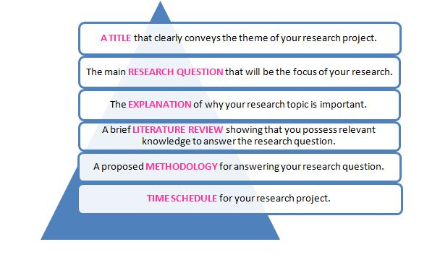

Slide 46
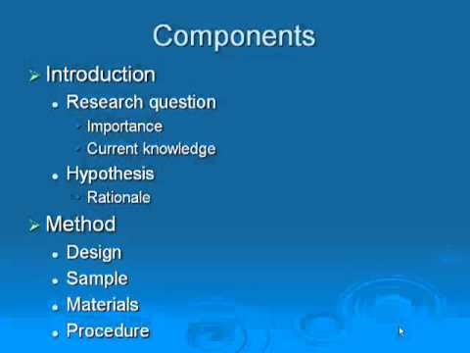

Slide 47
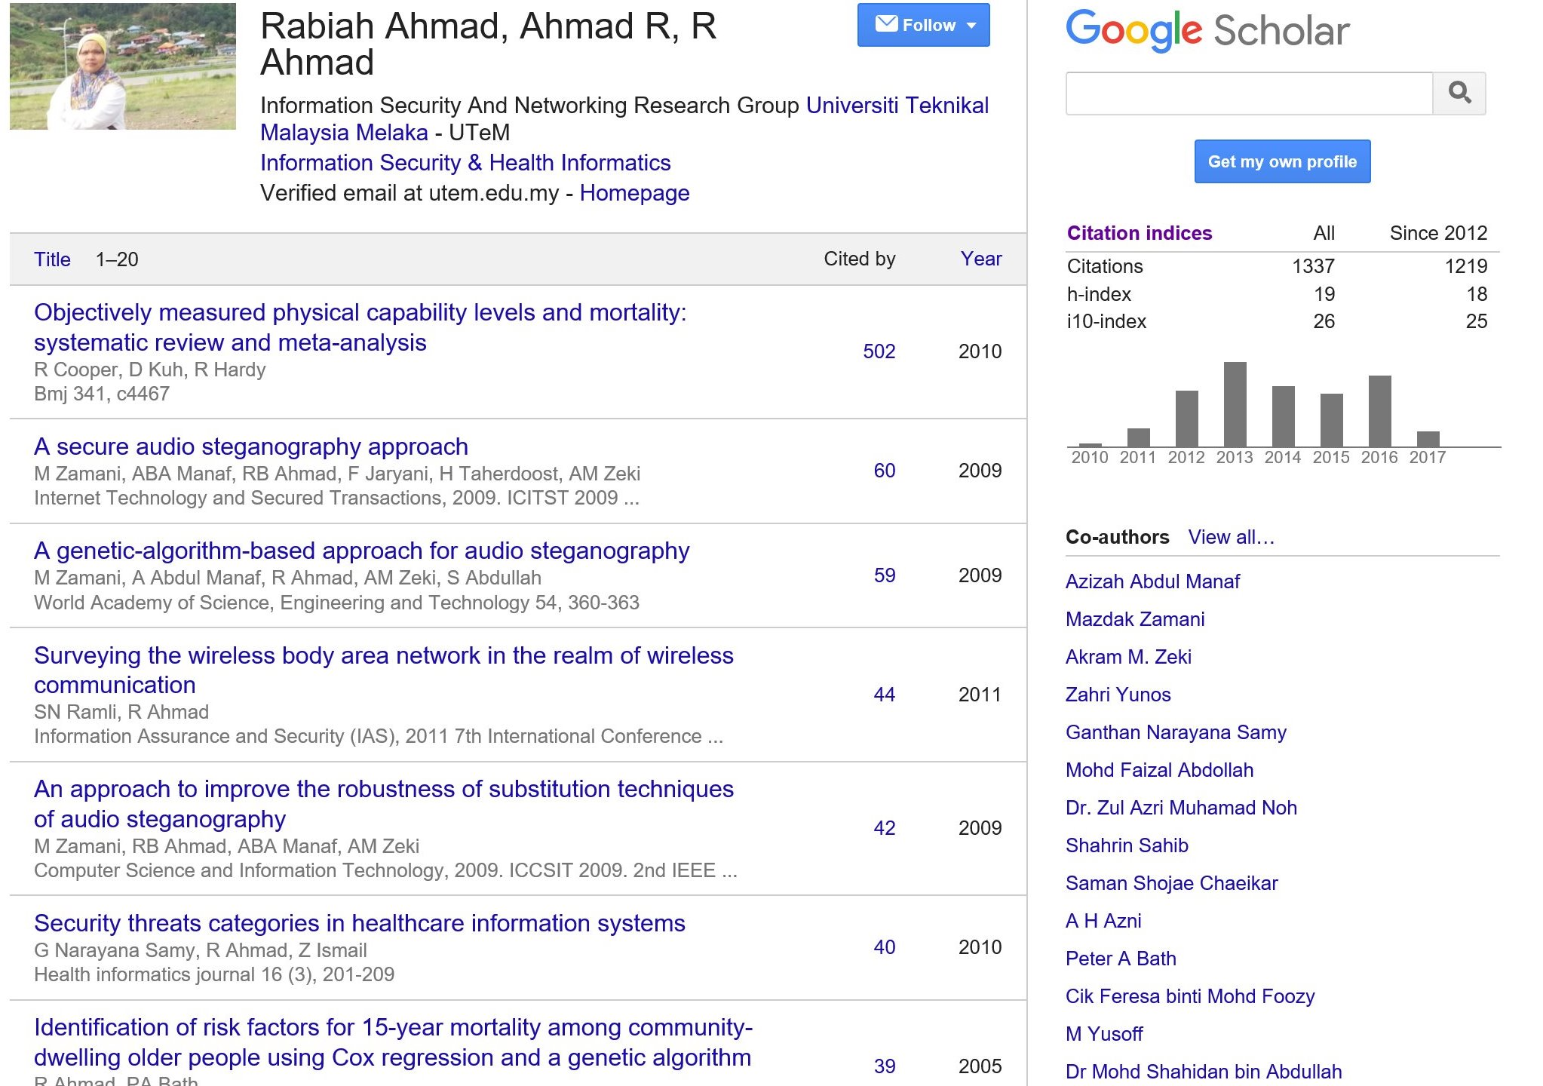
Sharing Experience

Slide 48
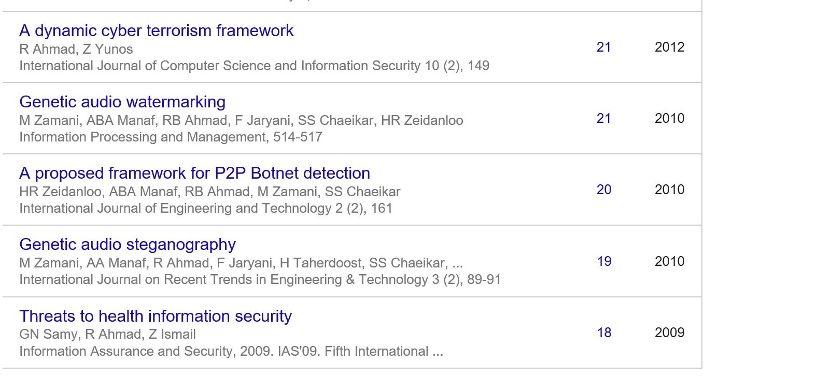

Slide 49
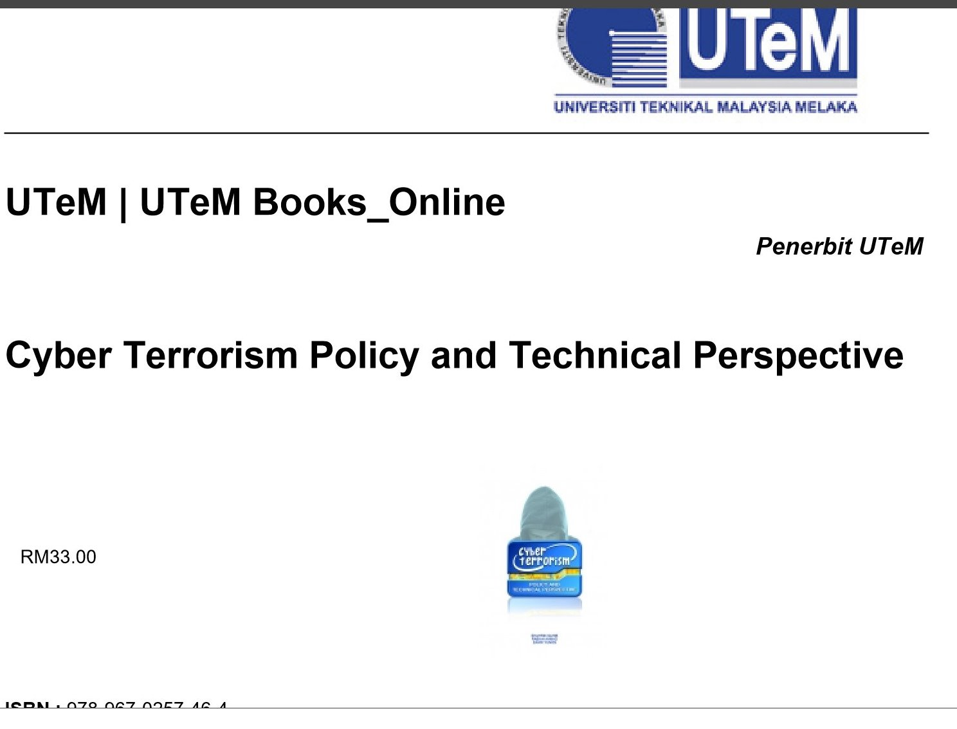

Slide 50
Writing Coaching
What | Why | What we can see | Action | Challenge
Proceeding
Journal
Chapter
…….

Slide 51
Writing Coaching
What | Why | What we can see | Action | Challenge
speaker
network
Scholar..
…….

Slide 52


