Slide 1





THESIS EVALUATION
Assoc. Prof. Dr. Norazah Nordin
Faculty of Education
Universiti Kebangsaan Malaysia

Slide 2

Content
Introduction
What is a thesis?
The purpose of a thesis
General Criteria of Thesis
Thesis Content
How to evaluate a thesis
Examples of thesis evaluation process
Conclusion

Slide 3
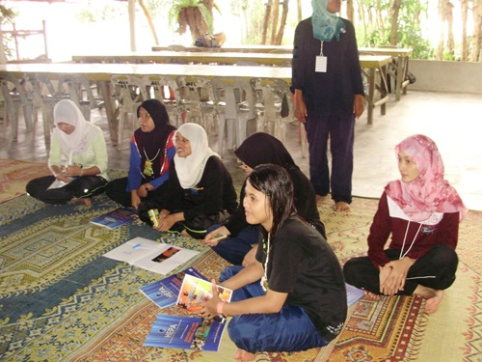
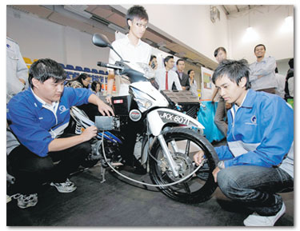

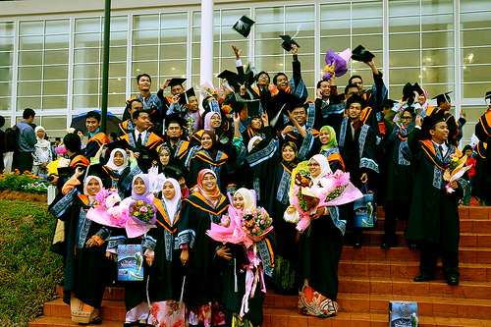


Slide 4
What is a thesis?
A thesis is a significant original body of work produced by a student and put into written form.

Slide 5
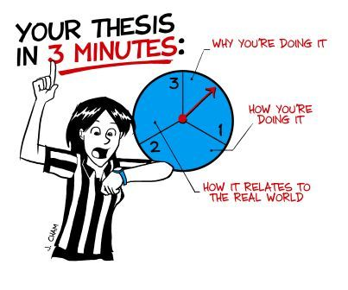

Slide 6

A Master’s Thesis
A Master’s thesis must show that the student is able to work in a scholarly manner and is acquainted with the principal works published on the subject of the thesis.
it should be an original contribution
demonstrate that the candidate is capable of original and independent work.

Slide 7

A Doctoral Thesis
A doctoral thesis must make a significant contribution to knowledge in a field of study, embody the results of original investigation and analysis, and be of such quality as to merit publication.

Slide 8


Slide 9
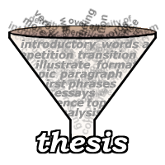
The purpose of writing a thesis…
to give evidence of a student's abilities in collecting and evaluating information
critically analyzing theories in the chosen area of inquiry, and constructing, testing and defending a coherent argument

Slide 10
The purpose of writing a thesis
demonstrate a student's ability to present research results concisely and in a scholarly form
demonstrate that the candidate is capable of original and independent work

Slide 11


Slide 12
General Criteria of a thesis
Focus
Reading
Research
Argument
Presentation

Slide 13
General Criteria
Focus
relevance to research problem and argument
retain a focus on the stated research problem and the proposed argument
develop a clear sense of core arguments
establish their relationship to the question or research problem being posed
sustain a focused development of the argument throughout the thesis
for every paragraph of a thesis there should be an answer to the question

Slide 14
Reading
thorough and critical use of a wide range of literature and theories
clearly provide evidence of the range of literature
care taken in selecting the texts most relevant to the thesis topic, efforts made to find sources independently
attempts made to follow up references
data generated and discussed are consistent with and support the arguments and interpretations put forward

Slide 15
Research
adequacy of research design and execution, consistency of interpretation
research design, its appropriateness for the thesis, and the adequacy of its execution
evidence of an appreciation of the range of different methodologies
how the chosen research design suits the topic
its possible limitations
data generated and discussed are consistent with and support the arguments and interpretations put forward

Slide 16
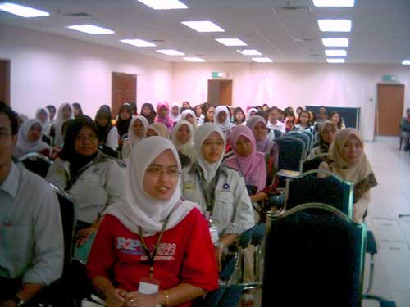
General Criteria
Argument
pursue analysis in addition to description, and the production of a line of reasoning going beyond mere reading and a descriptive account of data (where relevant)
present a coherently organized argument
clearly identify a formulated position on the topic and support therefore with arguments, dealing with arguments against as well as for it, and arrive at some sort of conclusion

Slide 17
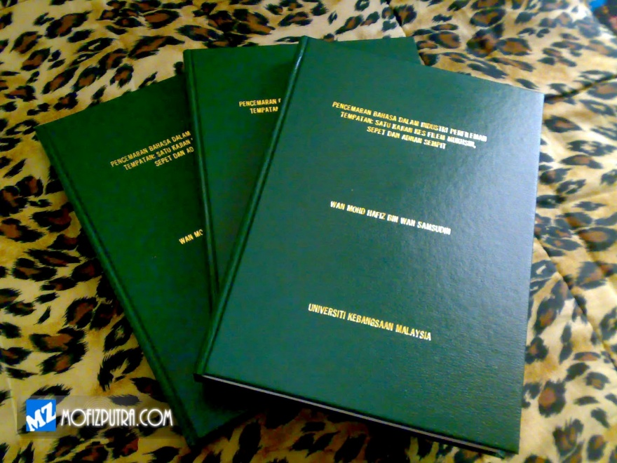
General Criteria
Argument
the presentation of a thesis and its reasoned defense
a distinguished thesis takes up an independent position in relation to the relevant literature on the topic
clearly demonstrate a depth and breadth beyond merely a literature review to establish a clear relation between the literature and the research, drawing conclusions and making connections not immediately evident in the existing literature itself

Slide 18

General Criteria
Presentation
competence in mechanics of essay writing and expression
Spelling, grammar, correct use of citations and construction of a bibliography must be impeccable
The bibliography must accurately represent all sources and reading
Material contained in tables or graphs must be clearly and adequately presented, and sources provided
The thesis must conform to the institution thesis writing guidelines.
The quality of expression is very important.

Slide 19
General Criteria
Presentation
structure and organize the topic well.
coherence: successive sentences should relate to each other, as should successive sections of the essay, and the grammar should make sense, and
unity: everything should be clearly related to thesis topic and to the propositions discussed.
structured in an appropriate academic style, containing those sub-sections required to organize the material with suitable sub-headings to signify the progression and structure of its arguments.
The contents page must correspondingly give a clear indication of the structure of the thesis.

Slide 20
Thesis Content
Introduction
Literature review
Methodology
Findings
Evaluation
Discussion
Conclusions and Recommendations
Acknowledgments
References

Slide 21
Abstract
The abstract is expected to give a concise account of the student's work so that a reader can quickly learn the essential contents and results.
A typical abstract includes
a statement of the problem
an account of procedures or methods followed
an account of main results
conclusions.

Slide 22
Thesis Content
Introduction
presenting information on the field of study and the question or hypothesis under research
focuses on the topicality, main objectives, tasks involved in the research
the research novelty, subject and object.

Slide 23
Introduction
You can't write a good introduction until you know what the body of the paper says.
Consider writing the introductory section(s) after you have completed the rest of the paper, rather than before. Be sure to include a hook at the beginning of the introduction.
This is a statement of something sufficiently interesting to motivate your reader to read the rest of the paper, it is an important/interesting scientific problem that your paper either solves or addresses.
You should draw the reader in and make them want to read the rest of the paper.

Slide 24
Introduction
The introduction should be focused on the thesis question(s). All cited work should be directly relevent to the goals of the thesis. This is not a place to summarize everything you have ever read on a subject.
Explain the scope of your work, what will and will not be included.
A verbal "road map" or verbal "table of contents" guiding the reader to what lies ahead.

Slide 25
Introduction
Introduction
The next paragraphs in the introduction should cite previous research in this area.
It should cite those who had the idea or ideas first, and should also cite those who have done the most recent and relevant work.
You should then go on to explain why more work was necessary (your work, of course.)
What else belongs in the introductory section(s) of your paper? A statement of the goal of the paper: why the study was undertaken, or why the paper was written. Do not repeat the abstract.
Sufficient background information to allow the reader to understand the context and significance of the question you are trying to address.

Slide 26

Thesis Content
Literature review
focusing on the researches into the subject carried out by outstanding scientists, whose ideas serve as the basis of the research
the most up-to-date researches
enumerate the drawbacks of out-dated ones
The more extended the list of the literature referred, the more argumentative the research will be.

Slide 27

Thesis Content
Methodology
mentioning the research question or hypothesis and suggesting one or more appropriate scientific methods with the help of which can answer the spotted question, or prove/reject the hypothesis that have been put forward in Introduction
convincingly justify the preferred methods of scientific research, stating both their advantages and limitations

Slide 28
Methods
Limitations, assumptions, and range of validity.
Desciption of your analystical methods, including reference to any specialized statistical software.
The methods section should answering the following questions and caveats: Could one accurately replicate the study (for example, all of the optional and adjustable parameters on any sensors or instruments that were used to acquire the data)?
Could another researcher accurately find and reoccupy the sampling stations or track lines?

Slide 29
Methods
What belongs in the "methods" section of a scientific paper? Information to allow the reader to assess the believability of your results.
Information needed by another researcher to replicate your experiment.
Description of your materials, procedure, theory.
Calculations, technique, procedure, equipment, and calibration plots.
Limitations, assumptions, and range of validity.

Slide 30
Thesis Content
Findings
outline a set of findings which make the original scientific contribution to the investigated subject area
extend the notion of ‘novelty’ briefly mentioned in Introduction by enumerating the finding obtained in the course of the research

Slide 31
Findings
The results are actual statements of observations, including statistics, tables and graphs.
Indicate information on range of variation.
Mention negative results as well as positive. Do not interpret results - save that for the discussion.
Lay out the case as for a jury. Present sufficient details so that others can draw their own inferences and construct their own explanations.

Slide 32
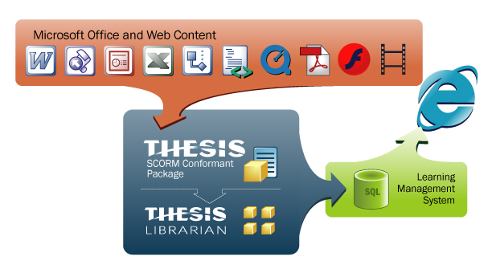
Thesis Content
Evaluation
critically assessing the degree to which you managed to answer the question or prove the hypothesis put forward at the beginning.

Slide 33
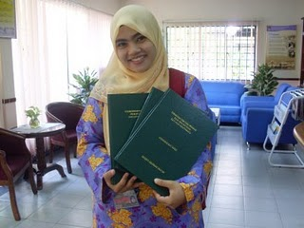
Thesis Content
Discussion
comparing your findings obtained in the course of the research with points of view communicated by outstanding scientists presented in Literature Review

Slide 34
Thesis Content
Conclusions and Recommendations
briefly summing up the whole research, underlining our novelty, findings, as well as giving suggestions for future research.

Slide 35
Conclusions
What is the strongest and most important statement that you can make from your observations?
If you met the reader at a meeting six months from now, what do you want them to remember about your paper?
Refer back to problem posed, and describe the conclusions that you reached from carrying out this investigation, summarize new observations, new interpretations, and new insights that have resulted from the present work.
Include the broader implications of your results.
Do not repeat word for word the abstract, introduction or discussion.

Slide 36
Recommendations
Include when appropriate (most of the time)
Remedial action to solve the problem.
Further research to fill in gaps in our understanding.
Directions for future investigations on this or related topics.

Slide 37

Thesis Content
Acknowledgments
Advisor(s) and anyone who helped you: technically (including materials, supplies)
intellectually (assistance, advice)
financially (for example, departmental support, travel grants)

Slide 38
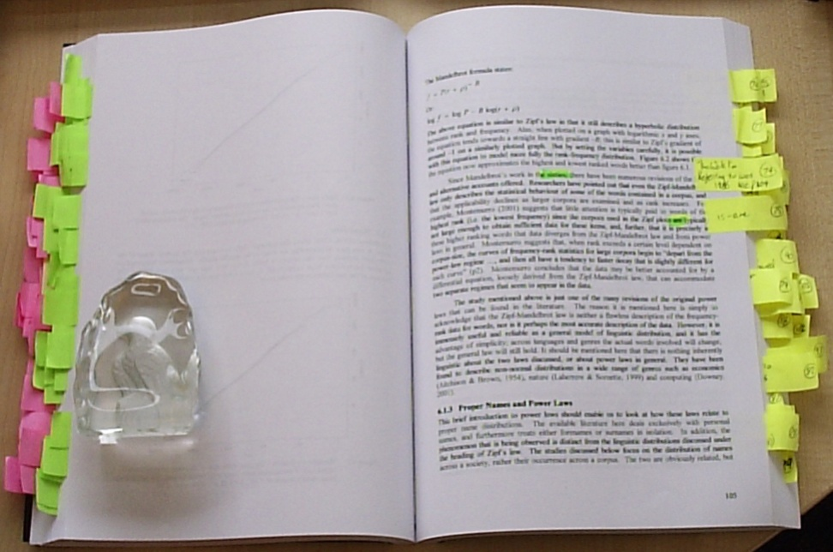
Thesis Content
Recommendations
Include when appropriate (most of the time)
Remedial action to solve the problem.
Further research to fill in gaps in our understanding.
Directions for future investigations on this or related topics.

Slide 39
Overall Performance
PASSED
A thesis is passed if it is acceptable in its present form or pending minor revisions
A thesis may be passed if no substantive changes are required.
Changes in the form of corrections to include typographical or grammatical errors, minor modifications to the thesis, editorial revisions or the like, may be recommended with a thesis classified as passed.

Slide 40
Overall Performance
Passed with Distinction
It is difficult to say how any particular combination of the above elements will translate into an assessment of a thesis.
It could be strong on some points and weaker on others, and we then have to balance that out.
outstanding on all of these points.
offer clear evidence of a performance at an outstanding level on all of the above criteria
demonstrate a very considerable depth and breadth of knowledge evidenced by a critical appreciation of the literature in all its extents, shows clear and outstanding ability to proceed to independent research
clearly demonstrable originality of thought, command of the field and research sophistication producing work of publishable quality in internationally refereed journals are candidates for this assessment.

Slide 41

Overall Performance
Passed with High Distinction
Indicates a work of superlative quality, worthy of the highest academic grade and outstanding in terms of originality, research, argument and expression.

Slide 42

Overall Performance
REFERRED
not acceptable in its present form, but could be acceptable pending major revisions.
requires substantive changes such as rewriting a chapter, reinterpretation of data, corrections to calculations or additional research in order to attain acceptable standards of coherence and integrity in argument and presentation

Slide 43
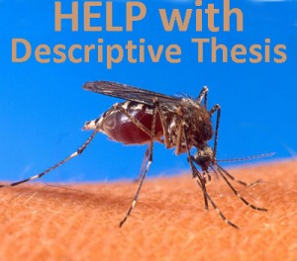
Overall Performance
FAILED
it is unacceptable to the discipline even with substantive revisions
the Committee returns two or more votes showing failure

Slide 44

Contoh
Panduan Menyediakan Laporan Tesis
(Doktor Falsafah)
UNIVERSITI KEBANGSAAN MALAYSIA
Pendahuluan
Bidang kajian: sama ada sesuatu yang baru dan bernilai atau sebaliknya.
Cara pengkajian: sama ada menepati bidang kajian dan memadai atau sebaliknya.
Lain-lain komen yang berkaitan dengan bidang kajian dan cara pengkajian yang dipilih oleh penulis.

Slide 45
Contoh
Panduan Menyediakan Laporan Tesis
(Doktor Falsafah)
UNIVERSITI KEBANGSAAN MALAYSIA
Kandungan
Apakah perkara-perkara yang cuba dikemukakan oleh penulis?
Adakah pendapat-pendapat penulis bernas dan mempunyai sokongan-sokongan yang kuat? Berikan contoh-contoh.
Perbincangan dan penghujahan serta contoh-contoh yang dipilih oleh penulis sama ada menepati apa yang mahu dikemukakan atau sebaliknya.
Apakah kekuatan dan kelemahan penyelidikan ini dari segi kandungan?
Kesimpulan dan rumusan yang dibuat oleh penulis.
Lain-lain perkara mengenai kandungan projek yang perlu dilaporkan.

Slide 46
Contoh
Panduan Menyediakan Laporan Tesis
(Doktor Falsafah)
UNIVERSITI KEBANGSAAN MALAYSIA
Penyampaian
Ejaan, gaya dan bahasa yang digunakan.
Kemampuan penulis menyampaikan hasil kajian/penyelidikan.
Lain-lain perkara mengenai penyampaian projek yang difikir perlu dilaporkan.

Slide 47
Contoh
Panduan Menyediakan Laporan Tesis
(Doktor Falsafah)
UNIVERSITI KEBANGSAAN MALAYSIA
Format
Susunan persembahan.
Penggunaan tajuk-tajuk kecil.
Teknik persembahan.
Lain-lain perkara mengenai format dan perkara-perkara teknikal yang difikirkan perlu dilaporkan. (Laporan mengenai cara menaip, catatan bawah, catatan bibliografi, penggunaan gambar-gambar dan lain-lain perkara mengenai bentuk fizikal projek tidak perlu dilaporkan kerana Universiti ini sudah mempunyai Buku Panduan menyediakan Tesis/Projek Penyelidikan/Disertasi yang mana penulis dikehendaki memenuhi syarat dalam buku tersebut sebelum diserahkan).

Slide 48
Contoh
Panduan Menyediakan Laporan Tesis
(Doktor Falsafah)
UNIVERSITI KEBANGSAAN MALAYSIA
Rumusan dan Cadangan Lain
Keputusan

Slide 49
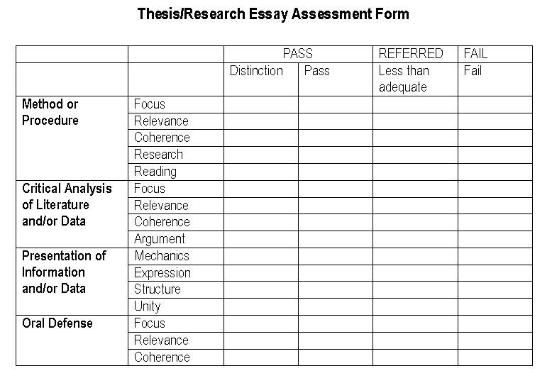

Slide 50
THESIS EVALUATION
Choice of topic, weight 10%
Use of sources and theoretical basis, weight 25%
– application of theory and framework
– field-specific development challenges
– selection and application of sources
– accuracy of concepts
Implementation, weight 25%
– compatibility between theoretical and empirical part
– definition of research and development task
– selection and applicability of research and development methods
– command of research and development methods
– implementation of development project
– process description

Slide 51
THESIS EVALUATION
4 Significance of results for development of professional practice, weight 30%
– significance for development of professional practice
– usability of output
– conclusions and discussion
5 Report, weight 10%
– language competence
– appearance
The target level descriptions presented in the instructions on writing a Bachelor's or Master's thesis shall be used in the evaluation; these descriptions may include field-specific requirements

Slide 52
THESIS EVALUATON
Choice of topic, weight 10%
Use of sources and theoretical basis, weight 25%
– application of theory and framework
– field-specific development challenges
– selection and application of sources
– accuracy of concepts
Implementation, weight 25%
– compatibility between theoretical and empirical part
– definition of research and development task
– selection and applicability of research and development methods
– command of research and development methods
– implementation of development project
– process description

Slide 53
Tips on Writing a Thesis
Because the best part of all, the absolutely most delicious part, is finishing it and then doing it over… I rewrite a lot, over and over again, so that it looks like I never did.
Novelist Toni Morrison

Slide 54
Conclusion
A good thesis is thoroughly researched, demonstrates rigorous critical thinking and analysis, presents a detailed methodology and accurate results, and includes tenacious verification of knowledge claims.

Slide 55
Thank you

