Slide 1

MESYUARAT PEMERIKSAAN BAJET
TAHUN 2013
CONTINUOUS MONITORING OF STUDENT PERFORMANCE
Prof. Dr. Shahrin bin Sahib@Sahibuddin
TNC (A&A)
___________________________________________
oleh: Prof Datuk Dr Ahmad Yusoff Hassan
Naib Canselor

Slide 2
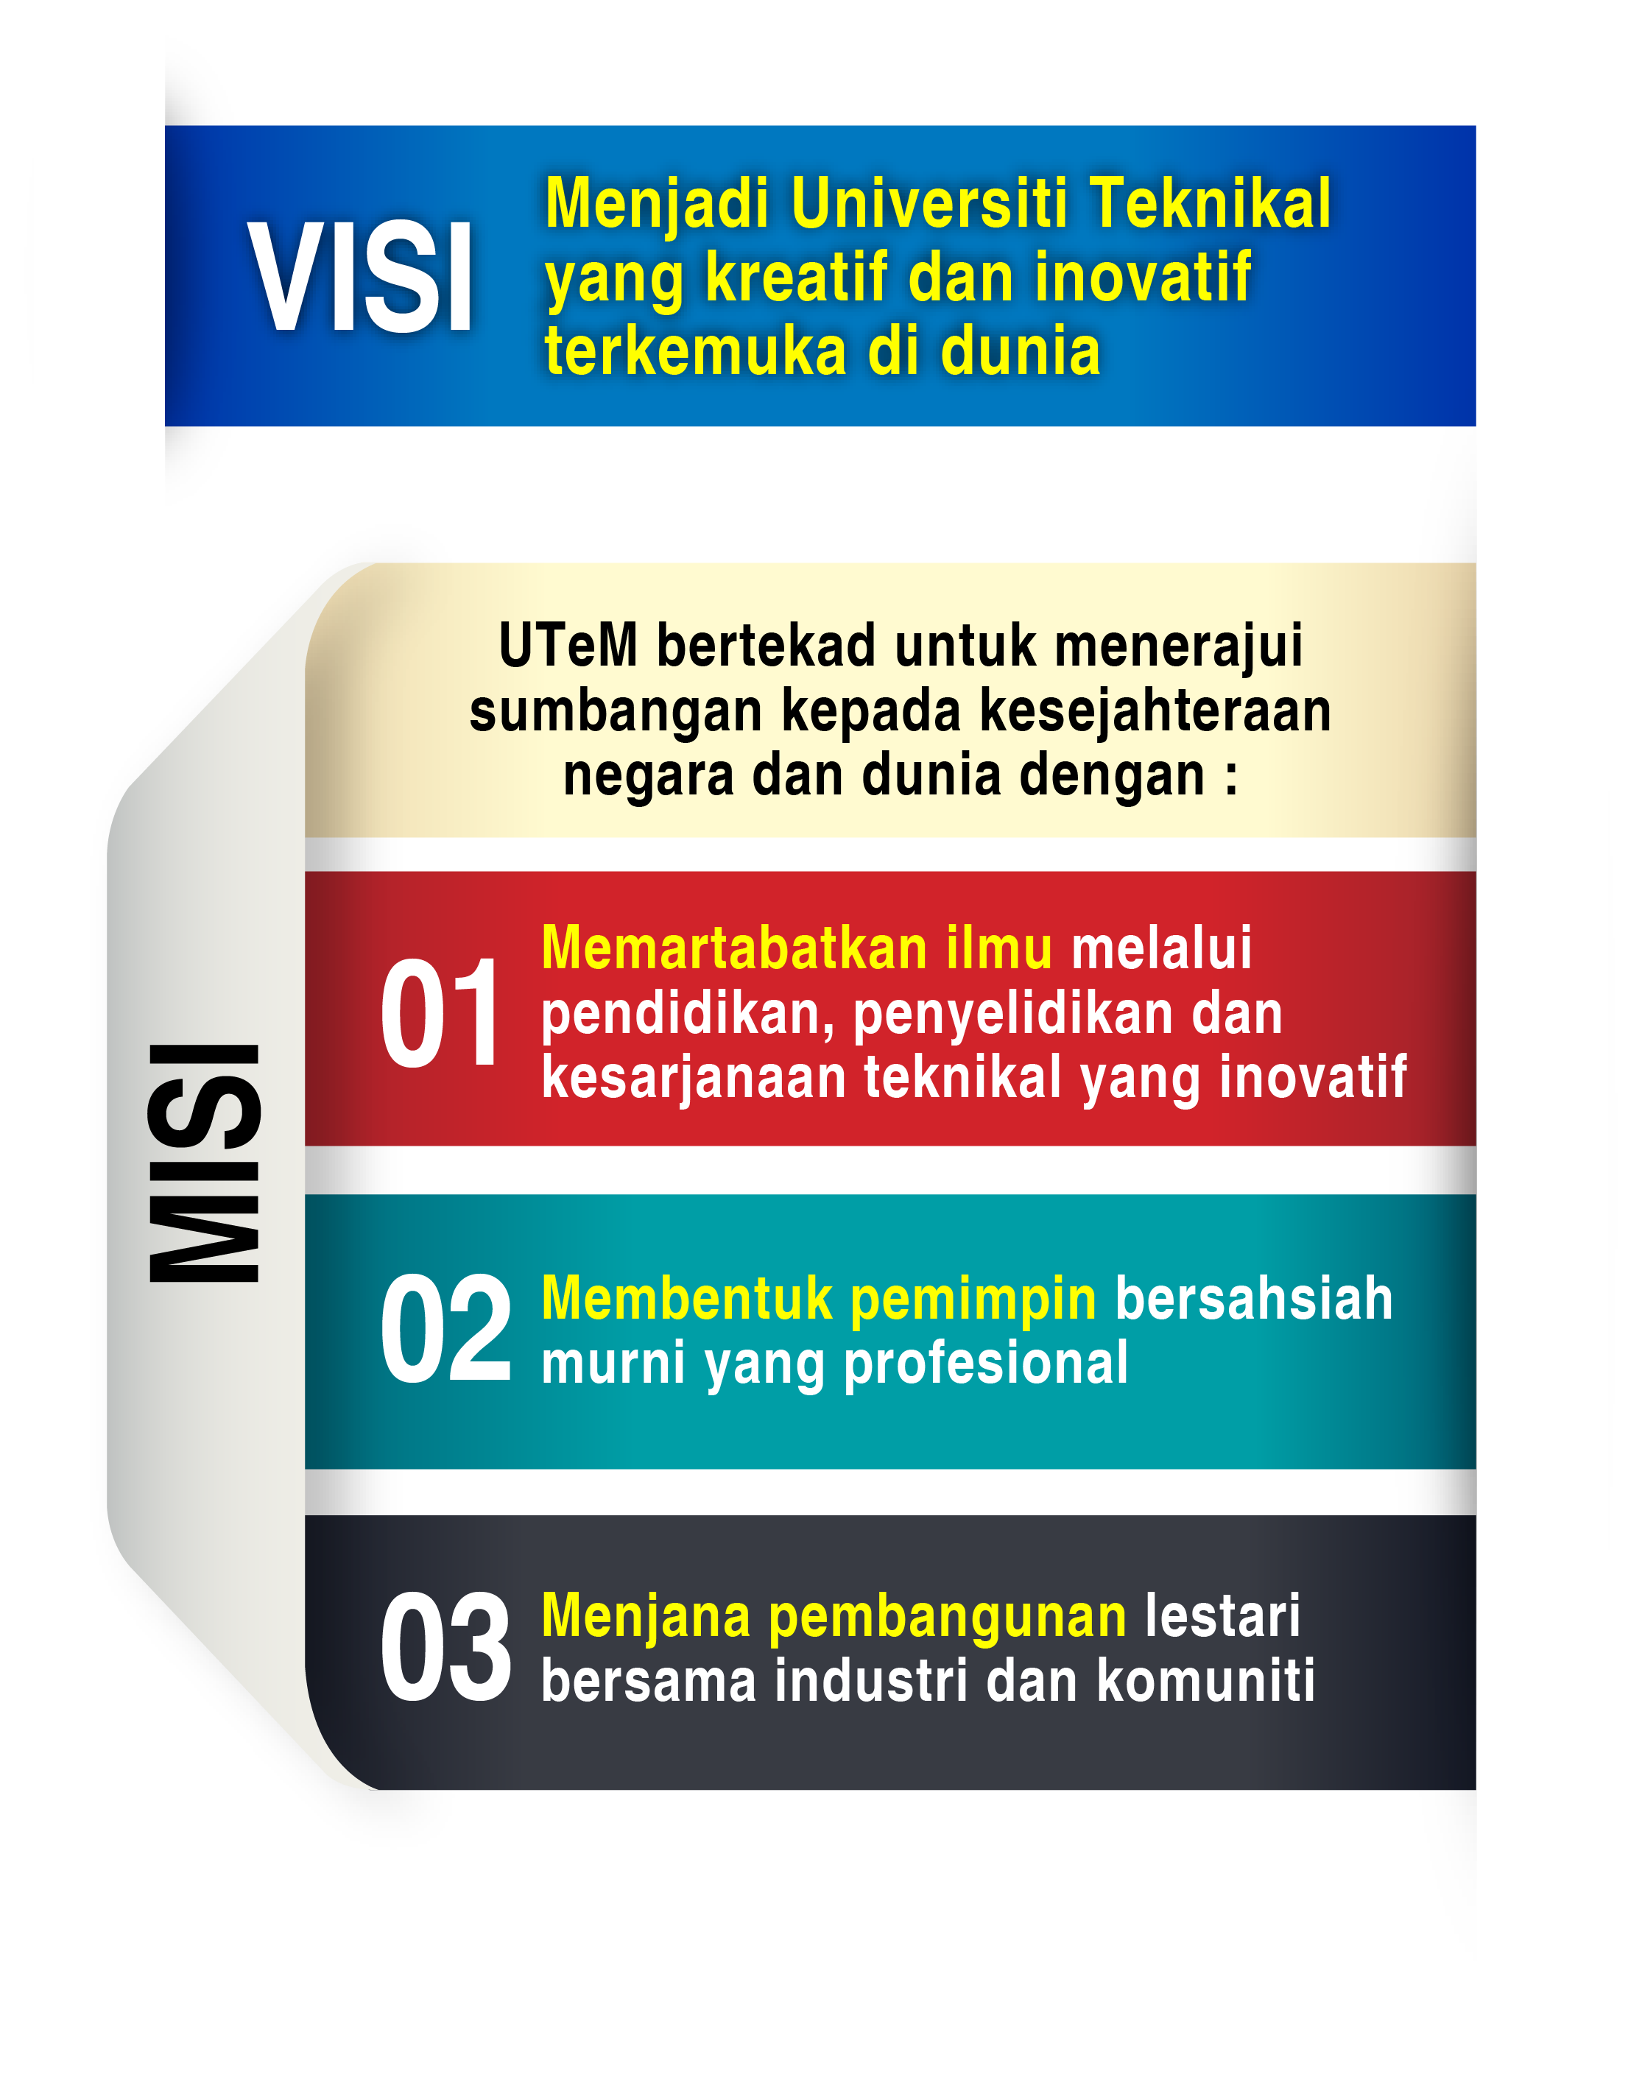


Slide 3





Always a Pioneer, Always Ahead
Sentiasa Merintis, Sentiasa Mendahului

Slide 4
SYNOPSIS
This workshop introduces the two important relationships of assessment in OBE: learning outcomes and soft skills (LO-KI), and learning outcomes and programme outcomes (LO-PO). Appropriate formative and summative assessment methods are identified for effective continuous monitoring of students’ performance.
In addition, this workshop also includes the reflective technique.

Slide 5
LEARNING OUTCOME
At the end of the workshop, participants should be able to:
  construct the matrices of LO-PO, LO-KI and PO-PEO;
  differentiate the implementation between formative and summative methods in monitoring students’ performance;
  design the rubrics for qualitative assessments;
  apply reflective technique for effective learning process.

Slide 6
CONTENTS
Mapping of LO-PO, LO-KI and PO-PEO
Types of Formative Assessments
Types of Summative Assessments
Selecting Appropriate Assessment Methods for Intended Learning Outcomes
Using Assessments for Grading and Supporting Learning
Continuous Assessment or Terminal Examination?
Design of Rubrics
Reflective Technique

Slide 7

PART A:
OBE AND ASSESSMENT

Slide 8
What is OBE?
Outcome Based Education OBE is a method of curriculum design and teaching that focuses on what students can actually do after they are taught.
OBE addresses the key questions as:
  Why do you want the students have/able to do? – Vision, Mission, PEOs, POs, LOs
  What do you want the students to learn? – course structure, syllabus
  How can you best help students learn it? – Learning Activities
  How will you know what they have learnt? - Assessment

Slide 9
Key Questions
Outcomes (Vision, Mission, PEO, PO, LO)
Delivery / T&L Activities
Course structure / syllabus
Assessment
Why do you want the students to have / able to do?
How can you best help students achieve it? – delivery
How can you best help students learn it? – Learning Activities
What do you want the students to learn?
How will you know what they have learnt?

Slide 10
CONT.
What is OBE?
OBE is a model of education that refuse the traditional focus on what the school provides to students, in favor of making students demonstrate that they "know and are able to do" whatever the required outcomes are.
A shift in focus from curricula, resources and processes towards outcomes and objectives such as how many hours students spend in class, or what textbooks are provided.

Slide 11
OBJECTIVES VS OUTCOMES
Objectives are the intended results or consequences of instruction, curricula, programs or activities
Outcomes are the achieved results or consequences of what was learned or evidence that some learning processes have taken place

Slide 12
WHY OBE?
MQA Accreditation & MQF
Engineering Accreditation Council (EAC)
Washington Accord, 1989
Improve Quality/Employability of Graduates

Slide 13
Advantages of OBE
1
2
CQI with input and feedback from various constituencies or external stakeholders
3
Students are well informed and trained of the skills required out of them
4
5
Encourage more exposures to professional practice through LI, site visits, industry through industry-linked projects or assignments, industry mentors, student dialogue with industry professionals or visiting industry speakers.
6
Higher assurance of the delivery of the outcome capabilities in every graduate.
Alert and concern : qualities of the graduates produced.
Encourage more systematic, innovative and flexible teaching approach or learning design ––for example: CL , PBL, etc.

Slide 14
What is the MQF?
The MQF forms the basis of a benchmarked, flexible and integrated system of qualifications moving towards the national objective of knowledge and a lifelong learning society

Slide 15
What is the MQF?
MQF* Para 1
MQF is an instrument that develops and classifies qualifications based on a set of criteria that is approved nationally and at par with international practices, and which clarifies the earned academic levels, learning outcomes of study areas and credit system based on student academic load.
* The Malaysian Qualifications Agency (2007), The Malaysian Qualifications Framework, Kuala Lumpur.

Slide 16
7 Principles of the MQF
Recognition for qualifications (certificates to doctoral);
Recognition of awarding sectors;
Levels of Qualifications;
Learning Outcomes;
Credit and Academic Load;
Flexibility of movement;
Educational Pathways for Individual Development (Lifelong Learning)

Slide 17
General Principles 1 & 2: Qualifications and Awarding Sectors
All Malaysian Qualifications
Certificate- Diploma -Advanced Diploma -Graduate
Certificate /Diploma -Degree –Postgraduate
Certificate/Diploma -Masters – Doctoral
All Higher Education Qualification Sectors
Skills – Vocational &Technical - Academic

Slide 18
General Principles 3 & 5: Levels of Qualifications & Minimum Graduating Credits
Level | MGC* | Sectors
 |  | Skills | Vocational & Technical | Academic
8 | - |  |  | Doctoral
7 | 40 30 20 |  |  | Masters Postgraduate Dip Postgraduate Cert
6 | 120 60 30 |  |  | Bachelor Graduate Dip Graduate Cert
5 | 40 | Advanced Diploma | Advanced Diploma | Advanced Diploma
4 | 90 | Diploma | Diploma | Diploma
3 | 60 | Certificate 3 | Certificate | Certificate
2 | - | Certificate 2
1 | - | Certificate 1
Note:
* MGC = Minimum Graduating Credits
Accredited Prior Experiential Learning
Accredited Prior Experiential Learning

Slide 19
General Principle 4: Learning Outcomes
(MQF Para 15) – LO Domains
1
2
3
Knowledge
Practical Skills
Social skills and responsibilities
4
5
Values, attitudes and professionalism
Communication, leadership and team skills
6
7
Problem solving and scientific skills
Information management and lifelong learning skills
8
Managerial and entrepreneurial skills

Slide 20
General Principles 6 & 7: Flexibility of Movement s & Pathways
Academic
8
7
6
5
4
3
Skills
Vocational and Technical
Doctoral
5
4 3
2
1
Postgraduate Cert
& Diploma
Masters
Bachelors
Graduate Cert & Diploma
Advanced
Diploma
Advanced
Diploma
Advanced
Diploma
Accredited Prior Experiential Learning (APEL)
Diploma
Diploma
Diploma
Certificate
Certificate
MATRICULATION/ FOUNDATION/ PRE-U
HIGHER SCHOOL CERT/
Certificate
SCHOOL CERT

Slide 21
Impact of MQF
The MQF, reflected in the QA documents, GUIDES the Agency, the HEP, related HE bodies/authorities and AFFECTS all programmes, systems, processes and activities pertaining to quality of higher education qualifications in Malaysia

Slide 22
Application of MQF
Impact on Quality Assurance
Impact on QA Documents
Learning Outcomes
Teaching and Learning
Credit System

Slide 23
How Does MQF Affect Teaching-Learning?
Teacher - centered
Student - centered
Learning Outcomes is the Learning Target
Mapping of learning outcomes necessary
Course Objective is the Learning Target
No mapping of learning outcomes
Student Independent Learning
Not Calculated
Contact hours
Reflects Credit value
Student independent Learning Time Calculated
Total SLT reflects Credit value

Slide 24
Lecturer-Centred to Student-Centred
(incorporating SLT)
 | Academic Activity (some examples) | Face 2 Face | Student Self- Learning* | Total
1 | Lecture | 1 | 2 | 3
2 | Tutorial | 1 | 2 | 3
3 | Laboratory/Practical | 3 | 2 | 5
4 | Assignment - 2000 words | 0 | 20 | 20
5 | Presentation | 1 | 4 | 5
 | Total | 6 | 30 | 36
Unaccounted for
in the previous system

Slide 25
MQF Learning Outcomes
MQF
statement on what students should know, understand and can do upon completion of a period of study.
In simple terms….
Specific, understandable, measurable, assessable and student-centered statements as to what a student will be able to do at the end of a period of study.

Slide 26
8 MQF Learning Outcome Domains
1
2
3
Knowledge
Practical Skills
Social skills and responsibilities
4
5
Values, attitudes and professionalism
Communication, leadership and team skills
6
7
Problem solving and scientific skills
Information management and lifelong learning skills
8
Managerial and entrepreneurial skills

Slide 27
Categories and Mapping of Learning Outcomes
Categories of Learning Outcomes (Para 14, MQF)
Evidence/Mapping of Learning Outcomes
qualifications
fields of study
programme
module/subject
Guided by Qualification Descriptors (MQF, Appendix 1)
How are these made relevant to the specific requirements of the field of study?
Map to curriculum and MQF Qualifications Descriptors
Map to Assessment

Slide 28
Planning MQF Credits
Qualification Levels & Minimum Graduating Credits
Teaching-Learning Activities
MQF CREDITS
NOTIONAL
LEARNING TIME
(1 Credit = 40 notional hours)
SLT according to Student Band

Slide 29
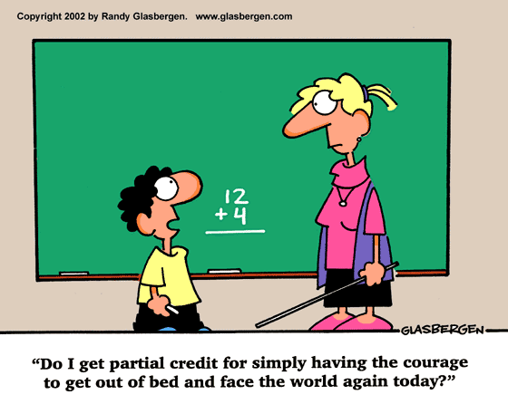
Credit for trying?

Slide 30
Credit =
the measurement of students’ academic load
A credit the agreed-upon value used to measure a student workload in terms of learning time required to complete course units, resulting in learning outcomes’ (UNESCO, 2004)
Teaching Learning
Activities
Achievement of Learning Outcomes
Lecture
Project Work
Study Tour
Demonstration
Tutorial
Presentation
Case study
Assignments
Laboratory
Revision
E-Learning
Clinical
Teaching/Learning + Assessment
Work attachment
Studio work
Group Discussion
Group Assignment
Field Work
Research Project
Examination
Industrial training
Directed reading
e.g. 4 800 notional SLT = 120 credits
Total SLT
40
Credit
Student Learning Time (SLT)

Slide 31
Factors In Calculating Credit
Face to Face / Guided Learning Time
+
Student Self Learning Time
+
Total Assessment Time

Slide 32
Student Categories and Learning Time
24 Hours
Routine Activities
Sleep
Travel
Self improvement Activities
Work
Total
Student
Time
Per day
Division of Student Time
Examples
Self-keep
Study
Hours per Week
Least Diligent - 40
Diligent - 48
Very Diligent - 55
Good = diligent; weak = least diligent

Slide 33
Examples
Notes:
33
33

Slide 34
Recommended Student Learning Time
(For a diligent student & 17-weeks Semester)
*17 weeks = 14 weeks of teaching, 1 week each for semester break, study break and examination
8 hours a day
48 hours a week
816 hours for 17-weeks*
20.4 credits per semester
5.8 semesters for a 120 credits bachelors

Slide 35
Student Categories &130 credit Bachelors
 |  | Least Diligent | Diligent | Very Diligent
1 | Number of weeks in a semester (A) | 17 | 17 | 17
2 | Recommended SLT per week (B) | 40 | 48 | 55
3 | Recommended total SLT per semester (C) [A x B] | 680 | 816 | 935
4 | Recommended credit per semester (D) [C ÷ 40] | 17 | 20 (20.4) | 23 (23.4)
5 | Total graduating credit for programme (E) | 130 | 130 | 130
6 | Number of semesters (long semester) (F) [E ÷ D] | 7.6 (7.64) | 6.5 | 5.7 (5.65)
7 | Number of academic year (2 long semesters 1 year) [F ÷ 2] | 3.8 | 3.3 (3.25) | 2.9 (2.85)

Slide 36
Proposed student independent learning time
Item | Duration (hours) or requirements | Proposed Student Self Learning Time (hours)
Lecture | 1 | 1-2
Tutorial | 1 | 1-2
Tutorial (involving case studies) | 1 | 3
Laboratory (including report writing) | 3 | 2-3
Undergraduate Final Year Project/ Dissertation | 6 - 10 credits | 200 - 400
Studio Work | 2 | 2
Presentation | 1 | 3-4
Coursework/Assignment | 2000 words | 10 - 12
Creative Writing (or a project that last a whole semester) | 100 – 150 pages | 8-10
Examination | 3 | 10 – 20*
Source: Bengkel Kebangsaan Pemantapan Sistem Kredit MQF, 31 Jan. – 2 Feb. 2005 by Quality Assurance Division, Ministry of Higher Education (Malaysia). * Proposed by MQA, depending on the field of study and the intensity of the examination.

Slide 37
Learning Outcomes and Student Learning Time
(A subject with 6 learning outcomes and 1.5 credit hours)
 | Learning Outcomes | Lecture | Tute | Self -learning | Total SLT
1 | explain the types of contracts; | 2 | 1 | 3 | 6
2 | distinguish between offer, acceptance and an invitation to treat; | 3 | 2 | 5 | 10
3 | differentiate the types considerations; | 2 | 1 | 3 | 6
4 | describe the principles concerning termination and breach of contract; | 4 | 2 | 4 | 10
5 | Summarise principles of damages; | 2 | 1 | 3 | 6
6 | Examine, analyse, compile, apply and justify the principles of contract in given scenario. | 0 | 3 | 6 | 9
- | Assessment (1 coursework and one 3-hour examinations) | 0 | 4 | 12 | 16
 | Total |  |  |  | 63

Slide 38
Module Academic Load & Credits
 | Learning Activities | SLT (in hours)
1 | Lectures | (54)
a | Attending Lectures | 24
b | Pre and Post preparation* | 30
2 | Tutorial | (18)
a | Attending tutorial | 9
b | Preparation for tutorial* | 9
3 | Laboratory | (36)
a | Practical | 24
b | Prepreparation and Report writing* | 12
 | Learning Activities | SLT (in hours)
4 | Assessments | (23)
a. | 1 continuos assessement (1 hour + 3 hours preparation*) | 4
b. | 1 presentation (1 hour + 5 hours preparation*) | 6
c. | 1 Final Examination (3 hour + 10 hours preparation*) | 13
 | Total | 131
 | Subject Credit (131 ÷ 40 = 3.27) | 3

Slide 39
Credits per semester
 | Modules | Face to Face Learning | Independent Learning | Lab Hours | Evaluation | Total SLT | Credit
1 | Genetics | 42 (2+1) | 42 | 26 | 16 | 126 | 3
2 | Biochemistry | 42 (2+1) | 42 | 26 | 16 | 126 | 3
3 | Cell Biology | 42 (2+1) | 42 | 12 | 16 | 112 | 3
4 | ICT | 28 (2+1) | 28 | 14 | 10 | 80 | 2
5 | English | 42 (2+1) | 63 | 14 | 7 | 127 | 3
6 | Moral/Islamic Studies | 28 (1+1) | 42 | 0 | 10 | 80 | 2
7 | Anatomy | 70 (3+2) | 42 | 0 | 16 | 128 | 3
 | Total | 294 | 301 | 92 | 91 | 778 | 19

Slide 40
Learning Outcomes
Credits
MQF
MQA
What students will be able to do?
The yardstick to measure student learning.
The frame within which students’ learning is pegged.
The Agency that holds all together.
The Big Picture

Slide 41
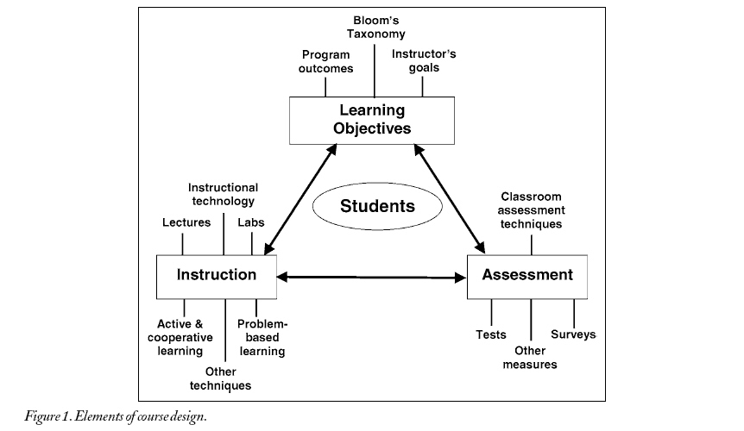
3 domains of educational goals (cognitive, psychomotor and affective)
What do I want my students to be able to do as a result of my teaching?
Learning
Outcomes
1
Planning
stage
What TL activities do I adopt to achieve the intended LO?
2
Implementation stage
Can my students do what I want them to be able to do?
3
Assessment stage

Slide 42
HIERARCHY OF Vision, Mission, EG, PEO, PO & LO
Institutional
Vision
Program Educational Objectives (PEO)
Institutional
Mission
Program Outcomes
(PO)
Educational
Goals
Subject / Learning Outcomes (LO)
Weekly / Topic Outcomes

Slide 44
To conduct academic and professional programmes based on relevant needs of the industries
To foster development and innovation activities in collaboration with industry and community for the prosperity of the Nation
To equip graduates with leadership and teamwork skills as well as develop communication and life-long learning skills
To develop technopreneurship and managerial skills amongst graduates
To instill an appreciation of the cultural values and awareness of healthy life styles amongst graduates
To produce graduates with relevant knowledge, technical competency, soft skills, social responsibility and accountability
To cultivate creative and innovative problem solving skills and autonomy in decision making amongst graduates
EDUCATIONAL
GOALS

Slide 45
Cognitive Domain
(Thinking, Knowledge)
EVALUATION
Judges the value of…….
SYNTHESIS
Formulates new structure
Understands both content
& structure
ANALYSIS
APPLICATION
Uses learning in new &
concrete situation
COMPREHENSION
Grasps the meaning
KNOWLEDGE
Remembers previous material
(Benjamin S. Bloom, 1956)

Slide 46
Psychomotor Domain
(Doing, Skills)
Creates new pattern…….
ORGANIZATION
ADAPTION
Adjusts, modifies, translates…..
Reforms automatically
COMPLETE OVERT
RESPONSE
Performs with
increasing efficiency
MECHANISM
GUIDES RESPONSE
Imitates the practice skills
SET
Mentally, emotionally & physically ready
PERCEPTION
Senses

Slide 47
Affective Domain
(Feeling, Attitude)
INTERNALIZING
Integrates value into value system
Conceptualizes value and
resolves conflict
ORGANIZATION
VALUING
Attaches value / worth
RESPONDING
Conform to stimuli
RECEIVING
Selectively attends to….

Slide 48
HIERARCHY OF PEO, PO, LO
ELEMENTS OF OBE
Program Educational Objectives (PEO)
Program Educational Objectives (PEOs)
Program Objectives (POs)
Learning Outcomes (LOs)
Assessment & Evaluation
Continual Quality Improvement (CQI)
Program Outcomes
(PO)
Subject / Learning Outcomes (LO)
Weekly / Topic Outcomes

Slide 49
Relationships – PEO, PO, LO and Stakeholders
Stakeholders
PEOs
POs
Subject LOs
Regulatory/Professional bodies
IHL requirements
Industries
Students
PEO1
PEO2
PEO3
PEO4
PEO5
PO1
PO2
PO3
etc
LO1
LO2
LO3
etc

Slide 50
Assessment, Evaluation & CQI Cycle – The Loop
“Am I involved in the process?”
Assessment
Assessment
YES YOU ARE !
Assessment
Evaluation
Evaluation
Evaluation
Program Educational Objectives (PEO)
Program Outcomes (PO)
Learning Outcomes (LO)
CQI
What students should achieved IMMEDIATELY AFTER graduated
CQI
What students should achieved after COMPLETING A SUBJECT
What students should achieved in 5 YEARS AFTER graduated
CQI
Notes:
50

Slide 51
Assessment, Evaluation & CQI Cycle
Assessment
Assessment
Assessment
Evaluation
Evaluation
Evaluation
Program Educational Objectives (PEO)
Program Outcomes (PO)
Learning Outcomes (LO)
CQI
CQI
What students should achieved in 5 YEARS AFTER graduated
CQI
Notes:
51

Slide 52
Program Educational Objectives (PEO)
Definition of Programme Objectives:
  “…broad statements that describe the career & professional accomplishments that the program is preparing the graduates to achieve.” (ABET Criteria 2004)
  “Broad goals that addresses institutional and program mission statements and are responsive to the expressed interests of various groups of program stakeholders” (Felder & Brent, 2003)
  Broad outcomes at career & professional level

Slide 53
Program Educational Objectives (PEO)
Beyond graduation and during professional development (typically between 4 -6 years of employment);
Minimum graduate registration of 4 years from accredited engineering programs before sitting for professional interview;
Minimum graduate registration of 6 years from non-accredited engineering programs after bridging programs before qualifying for professional interview

Slide 54
Program Educational Objectives (PEO) by EAC
Programme Objectives are specific goals consistent with the mission and vision of the IHL, that are responsive to the expressed interest of programme stakeholders, describing the expected achievements of graduates in their career and professional life few years after graduation.
The programme shall have a clear linkage between Programme Objectives and Programme Outcomes.
 | Programme Objectives (Faculty) | Programme Outcomes (Faculty)
 |  | PO1 | PO2 | PO3 | PO4 | PO5 | PO6 | PO7 | PO8 | PO9
a | Apply knowledge and skills that are application and practice-oriented in the field of mechanical engineering | x | x | x |  |  |  |  | x
b | Formulate and implement solutions for complex mechanical engineering problems with competency and creativity. | x | x | x | x |  | x
c | Pursue continuous professional development. |  | x |  | x |  | x | x | x
d | Conduct professional duties ethically and upholds sustainability. |  |  | x | x | x | x
e | Communicate effectively at all level of societies and posses good leadership qualities with global visions. |  |  |  |  | x |  | x | x | x
f | Adapt and complete in multi-cultural working environment, locally and internationally. |  |  |  |  | x | x | x | x | x

Slide 55
Characteristics of Good PEO
Should be stated such that a graduate can demonstrate in their career or professional life after graduation (long term in nature)
Distinctive/unique features/having own niche
Specific, measurable, achievable, result oriented and having a time frame
Clear, concise, consistence and reachable
Has clear link to PO & Curriculum design
Review, revised & updated continually published

Slide 56
Example of PEO - FKE
PEO for the Electrical Engineering Program at Faculty of Electrical Engineering.
  To produce graduates who practice electrical engineering knowledge in broad engineering applications as related to manufacturing, process, robotics, project development, utilities industry, services, maintenance, management, and research development.
  To produce graduates who are successful in engineering career, possess leadership quality, able to work independently, and practice professional ethical conduct.
  To produce graduates who engage with life-long learning and adapt to constantly evolving technology and entrepreneurial skills.

Slide 57
Example of PEO - FKE
PEO for the Mechatronics Engineering Program at Faculty of Electrical Engineering.
  To produce graduates who practice mechatronics engineering knowledge in broad engineering applications as related to manufacturing, process, robotics, project development, utilities industry, services, maintenance, management, and research development.
  To produce graduates who are successful in engineering career, possess leadership quality, able to work independently, and practice professional ethical conduct.
  To produce graduates who engage with life-long learning and adapt to constantly evolving technology and entrepreneurial skills.

Slide 58
Assessment, Evaluation & CQI Cycle
Assessment
Assessment
Assessment
Evaluation
Evaluation
Evaluation
Program Educational Objectives (PEO)
Program Outcomes (PO)
Learning Outcomes (LO)
CQI
What students should achieved IMMEDIATELY AFTER graduated
CQI
CQI
Notes:
58

Slide 59
PROGRAM OUTCOMES (PO)
  “Statements that describe what students are expected to know or be able to do by the time of graduation” (ABET Criteria 2004)
Knowledge, skills and behaviors that students acquire throughout the program
Typically 4 years of B.Eng. Program
  Intake after STPM/Matriculation = 4 years

Slide 60
Characteristics of Good PO
Each PO describes an area of knowledge and/or skills that a person can possess;
Should be stated such that a student can demonstrate before or by the time of graduation;
Should be supportive/responsive to one or more programme objectives, PEO (linked);
Do not have to include measures or performance expectations.

Slide 61
Characteristics of Good PO – Cont.
Take advantage of the unique character of the institution;
Should meet the specific programme criteria;
Package: knowledge, skill, attitude;
Cover the minimum of the 8 domains in MQA or a – j of the EAC manual for engineering programme in Malaysia.

Slide 62
EXAMPLE OF EAC VS FKM PO
No | PO EAC | PO FKM
1 | ability to acquire and apply knowledge of science and engineering fundamentals | Acquire and apply the fundamental principles of science and engineering
2 | acquired in‐depth technical competence in a specific engineering discipline | Acquire in depth specific application and practice-oriented mechanical engineering knowledge
3 | ability to undertake problem identification, formulation and solution | Undertake problem identification, formulation and solution.
4 | ability to utilize systems approach to design and evaluate operational performance | Utilize a systematic approach to design and evaluate operational performance
5 | understanding of the principles of design for sustainable development
6 | understanding of professional and ethical responsibilities and commitment to them | Understand the ethics of social, cultural and environmental responsibilities of a professional engineer as well as the needs for sustainable development (*)
7 | ability to communicate effectively, not only with engineers but also with the community at large | Communicate effectively, not only with engineers but also with the community at large
8 | ability to function effectively as an individual and in a group with the capacity to be a leader or manager | Function effectively as an individual and as a leader in a group or a member of a team
9 | understanding of the social, cultural, global and environmental responsibilities of a professional engineer; and | (*)
10 | recognizing the need to undertake life‐long learning, and possessing/acquiring the capacity to do so | Recognize the need to embark on lifelong learning, and posses/acquire the capacity to do so
 |  | Recognize the importance of entrepreneurship knowledge and skills.
Notes:
62

Slide 63
Assessment, Evaluation & CQI Cycle
Assessment
Assessment
Assessment
Evaluation
Evaluation
Evaluation
Program Educational Objectives (PEO)
Program Outcomes (PO)
Learning Outcomes (LO)
CQI
CQI
What students should achieved after COMPLETING A SUBJECT
CQI
Notes:
63

Slide 64
Characteristics of Good LO
Cover most of the related topics in the subject;
Cover most of the related level of Bloom Taxonomy;
Should have 3 main components – verb (V), condition (C) and standard (S);
Well written verbs must be SMART – Specific, Measurable, Achievable, Realistic, Time Frame, Observable;
Condition – context/situation which the behavior is to occur;
Standard - criteria of acceptable level of performance

Slide 65
Example of LO
Example 1
explain the operation and construction of semiconductor devices (V)
Orally explain on operation and construction of semiconductor devices (V,C)
Orally explain on operation and construction of semiconductor devices such as Diode, BJT, FET, MOSFET and Op Amp. (V,C,S)
Example 2
simulate the operation of semiconductor devices. (V)
simulate the operation of semiconductor devices using simulation software. (V,C)
simulate the operation of semiconductor devices using PSPICE simulation software for ideal case. (V,C,S)

Slide 66
Assessment, Evaluation & CQI Cycle
Assessment
Tests/exams/
Assign, etc
“How do you assess?”
Assessment
Assessment Tools !
Survey, Interviews,
Questionnaires
Assessment
Evaluation
Evaluation
Evaluation
Program Educational Objectives (PEO)
Program Outcomes (PO)
Learning Outcomes (LO)
CQI
CQI
CQI
Notes:
66

Slide 67
What is Assessment?
The word ‘assess’ comes from the Latin verb ‘assidere’ meaning ‘to sit with’.
In assessment one is supposed to sit with the learner. This implies it is something we do ‘with’ and ‘for’ students and not ‘to’ students (Green, 1999).
Assessment in education is the process of gathering, interpreting, recording, and using information about pupils’ responses to an educational task. (Harlen, Gipps, Broadfoot, Nuttal,1992)

Slide 68
The State of Assessment
“A wealth of research – a poverty of practice.” (Black and Wiliam, 1998)
Shift from “teaching” to “learning”
Preservice and inservice training
Confusion of terms and conditions
  Evaluation
  Assessment
    Formative
    Summative

Slide 69
Values and Attitudes about Assessment
Teachers value and believe in students.
Sharing learning goals with the students.
Involving students in self-assessment.
Providing feedback that helps students recognize their next steps and how to take them.
Being confident that every student can improve.
Providing students with examples of what we expect from them.

Slide 70
Formative Assessment
Assessment for learning
Taken at varying intervals throughout a course to provide information and feedback that will help improve
  the quality of student learning
  the quality of the course itself

Slide 71
“…learner-centered, teacher-directed, mutually beneficial, formative, context-specific, ongoing, and firmly rooted in good practice" (Angelo and Cross, 1993).
Provides information on what an individual student needs
  To practice
  To have re-taught
  To learn next

Slide 72
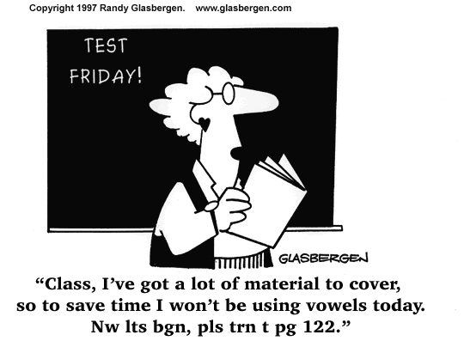

Slide 73
Key Elements of Formative Assessment
The identification by teachers & learners of learning goals, intentions or outcomes and criteria for achieving these.
Rich conversations between teachers & students that continually build and go deeper.
The provision of effective, timely feedback to enable students to advance their learning.
The active involvement of students in their own learning.
Teachers responding to identified learning needs and strengths by modifying their teaching approach(es).
  Black & Wiliam, 1998

Slide 74
Summative Assessment
Assessment of learning
Generally taken by students at the end of a unit or semester to demonstrate the "sum" of what they have or have not learned.
Summative assessment methods are the most traditional way of evaluating student work.
"Good summative assessments--tests and other graded evaluations--must be demonstrably reliable, valid, and free of bias" (Angelo and Cross, 1993).

Slide 75
Formative
‘… often means no more than that the assessment is carried out frequently and is planned at the same time as teaching.’ (Black and Wiliam, 1999)
‘… provides feedback which leads to students recognizing the (learning) gap and closing it … it is forward looking …’ (Harlen, 1998)
‘ … includes both feedback and self-monitoring.’ (Sadler, 1989)
‘… is used essentially to feed back into the teaching and learning process.’ (Tunstall and Gipps, 1996)
Summative
‘…assessment (that) has increasingly been used to sum up learning…’(Black and Wiliam, 1999)
‘… looks at past achievements … adds procedures or tests to existing work ... involves only marking and feedback grades to student … is separated from teaching … is carried out at intervals when achievement has to be summarized and reported.’ (Harlen, 1998)

Slide 76
The Garden Analogy
If we think of our students as plants …
Summative assessment of the plants is the process of simply measuring them. It might be interesting to compare and analyze measurements but, in themselves, these do not affect the growth of the plants.
Formative assessment, on the other hand, is the equivalent of feeding and watering the plants appropriate to their needs - directly affecting their growth.

Slide 77
Factors Inhibiting Assessment
A tendency for teachers to assess quantity and presentation of work rather than quality of learning.
Greater attention given to marking and grading, much of it tending to lower self esteem of students, rather than providing advice for improvement.
A strong emphasis on comparing students with each other, which demoralizes the less successful learners.

Slide 78
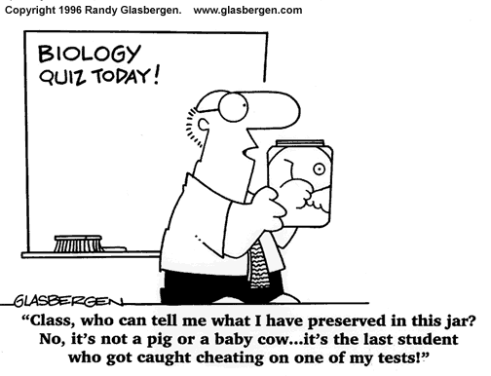

Slide 79
Forms of Summative Assessment
Performance Assessment
Portfolio
Traditional Tests

Slide 80
Implications for classroom practice
Share learning goals with students.
Involve students in self-assessment.
Provide feedback that helps students recognize their next steps and how to take them.
Be confident that every student can improve.

Slide 81
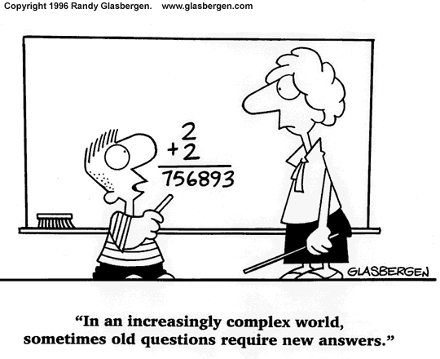

Slide 82

So What is Assessment?
Processes that identify, collect, use and prepare data for evaluation of achievement of program outcomes or educational objectives;
Need for practical assessment and effective assessment planning;
PEOs, POs and LOs should be measurable
(surveys, questionnaires, interviews, exams, tests, practical)

Slide 83
ASSESSMENT PROCESS
Formative and Summative Assessment
  Formative – collecting information according to preset criteria to furnish feedback on how learning can be improved and achieved (Coursework)
  Summative – judging the worth according to preset criteria of student’s demonstration of outcome attainment competence, that is, summing up a person achievement (Final Exam)
PO Assessment and CQI
Assessment Cycle

Slide 84

Formative & Summative Assessment Cycle
Start Process
  * Program Outcomes
  * Course Outcomes
  * Program Implementation
  * Course Implementation
  * Program Assessment
  * Course Assessment
Continue Process

Slide 85
Five Assessment Principles
(after Thomas Angelo & Patricia Cross 1993)
To improve their teaching, faculty must define learning outcomes and measure their attainment.
To improve their learning, students must learn how to use feedback to assess their own progress (= “self-assessment”).
The best assessment derives from teachers’ questions about their own teaching.
Systematic assessment can be an intellectually challenging source of faculty satisfaction.
Assessment provides an impetus for active student involvement, a proven “best practice”.

Slide 86
Assessment, Evaluation & CQI Cycle
Assessment
Assessment
Assessment
Evaluation
Evaluation
Evaluation
Program Educational Objectives (PEO)
Program Outcomes (PO)
Learning Outcomes (LO)
CQI
CQI
What students should achieved after COMPLETING A SUBJECT
CQI
Notes:
86

Slide 87
RECAP What is evaluation?
Processes for reviewing and interpretation of data and evidence from assessment practices that determine program outcomes are achieved or result in actions to improve program;
Analysis of assessment data for action plan;
Need for robust evaluation planning;
Importance for curriculum review.

Slide 88

Evaluation (cont.)
Action to be taken
  Improvement of course work
  Improvement of exam work
  Teaching assessment

Slide 89
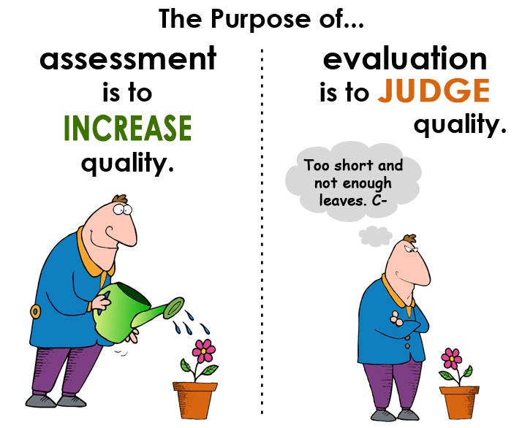
Assessment vs Evaluation

Slide 90
Good Practice in UG Education
(after Arthur Chickering & Zelda Gamson 1989)
Maximizes student/faculty contact.
Develops student cooperation.
Uses active learning techniques.
Gives feedback promptly.
Emphasizes time on task.
Communicates high expectations.
Respects learners’ diversity.

Slide 91
Assessment n Evaluation (various sources, but especially Dan Apple 1998)
Reflective: Internally Defined Criteria/Goals | Prescriptive:External-ly Imposed Standards
Diagnostic: Identify Areas for Improvement | Judgmental: Arrive at an Overall Grade/Score
Flexible: Adjust As Problems Are Clarified | Fixed: To Reward Success, Punish Failure
Absolute: Strive for Ideal Outcomes | Comparative: Divide Better from Worse
Cooperative: Learn from Each Other | Competitive: Beat Each Other Out

Slide 92
Summary of Differences
Dimension of Difference | Assessment | Evaluation
Timing | Formative | Summative
Focus of Measurement | Process-Oriented | Product-Oriented
Relationship Between Administrator and Recipient | Reflective | Prescriptive
Findings, Uses Thereof | Diagnostic | Judgmental
Ongoing Modifiability of Criteria, Measures Thereof | Flexible | Fixed
Standards of Measurement | Absolute | Comparative
Relation Between Objects of A/E | Coöperative | Competitive

Slide 93
Assessment, Evaluation & CQI Cycle
Assessment
Assessment
Assessment
Evaluation
Evaluation
Evaluation
Program Educational Objectives (PEO)
Program Outcomes (PO)
Learning Outcomes (LO)
CQI
CQI
CQI
Notes:
93

Slide 94
CQI of OBE Using PDCA Method
Communicate the results
Identify problem and find solution
Make some necessary change to the plan
PEO, PO, Matrix, SLT, LOKI, TP
ACTION
PLAN
CHECK
DO
T&L activities
Assess students learning
Collect appropriate data
Analyze the data
Compare result with plan / achievement
Monitoring/ reviewing process

Slide 95
Closing The Loop!
Assessment
Assessment
Assessment
Evaluation
Evaluation
Evaluation
Program Educational Objectives (PEO)
Program Outcomes (PO)
Learning Outcomes (LO)
CQI
CQI
CQI
Notes:
95

Slide 96

SOFT SKILL (MOE)
Communication skill (CS)
Critical thinking & problem solvings (CTPS)
Teamwork skill (TS)
Lifelong learning & Info Management (LL)
Entrepreneurship skills (ES)
Leadership skills (LS)
Ethics & Moral Professional (EM)

Slide 97
MoE & MQA LEARNING OUTCOMES
No | MQA | MoHE
1 | Mastery of Body of Knowledge | Knowledge
2 | Practical Skills | Practical Skill
3 | Social Accountability
4 | Ethics, Shared Values & Professionalism | Moral & Professional Ethic
5 | Scientific Method, Critical Thinking & Problem Solving | Critical Thinking & Problem Solving
6 | Communication Skills & Team Work | Communication
 |  | Teamwork
7 | Information Management & Life Long Learning | Life-long Learning & Information Management
8 | Entrepreneurship | Entrepenuership
9 |  | Leadership
Notes:
97

Slide 98
PO VS SOFTSKILL (example: FKM)
Program Outcomes (PO) | Soft Skill (KI)
PO1
PO2
PO3 | Critical Thinking & Problem Solving (CTPS)
PO4
PO5 | Leadership Skill, Teamwork Skill (LS,TS)
PO6 | Ethics & Moral (EM)
PO7 | Communication Skill (CS)
PO8 | Life Long Learning (LL)
PO9 | Entrepreneurship Skill (ES)

Slide 99
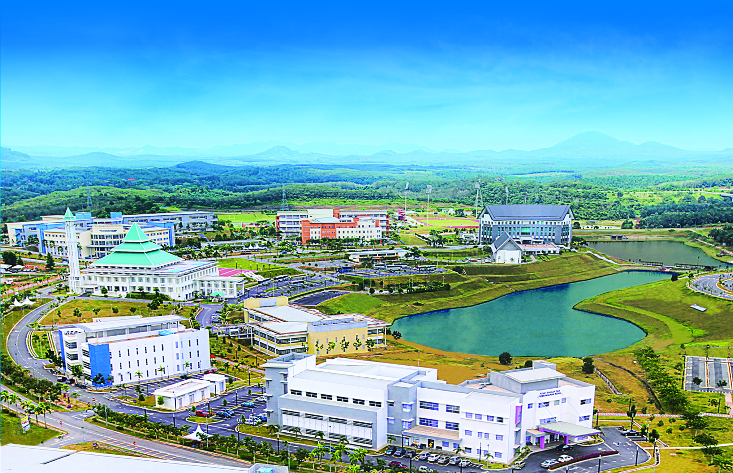
PART B:
RUBRICS AND REFLECTIVE TECHNIQUE

Slide 100

APA ITU RUBRIK?
Panduan atau matriks penskoran yang piawai;
Instrumen penskoran untuk pentaksiran prestasi (performance);
Mengenalpasti kriteria penting dan tahap prestasi/kejayaan bagi setiap kriteria;
Menjelaskan perbezaan kualitatif dan kuantitatif.

Slide 101
Sambungan..
Mengandungi kriteria yang didefinisi dengan baik dan digunakan dengan sistematik;
Berguna untuk mentaksir perlakuan atau produk yang mempunyai komponen subjektiviti yang tinggi (tidak boleh diskor secara objektif);
Contoh: persembahan lisan, reka bentuk projek, kemahiran berpasukan, kepimpinan.

Slide 102
KOMPONEN RUBRIK
KRITERIA/STANDARD
  Ciri-ciri/unsur-unsur prestasi yang baik dalam melakukan tugasan
TAHAP PRESTASI/KEJAYAAN
  Digunakan untuk menentukan sejauh mana pelajar telah memenuhi kriteria yang ditentukan
  Memberi jangkaan yang jelas kepada pelajar
  Memberi maklum balas yang lebih baik

Slide 103
Sambungan..
DESKRIPTOR – Menjelaskan jangkaan ke atas pelajar pada setiap tahap prestasi bagi setiap kriteria
MEKANISME UNTUK MENENTUKAN SKOR
CONTOH: 1 – Lemah, 2 – Baik, 3 – Cemerlang
Setiap kriteria boleh diberi pemberatan yang berbeza

Slide 104
Bentuk Penskoran Rubrik
Rows
  Apa yang akan ditaksirkan
  Hasil
Lajur (Columns)
  Tahap prestasi bagi setiap hasil
  Daripada “Boleh di terima kepada Tidak Boleh diterima”
  Skor ditentukan kepada setiap tahap
Sel (Cells)
  Deskripsi tentang apa yang terangkum pada setiap tahap prestasi untuk sesuatu hasil
* Rows and columns may be switched

Slide 105
CONTOH RUBRIK :
KEMAHIRAN KOMUNIKASI
TAHAP | CEMERLANG 4 | BAIK 3 | SEDERHANA 2 | LEMAH 1 | MARKAH
CS2 (KIM) Kebolehan mengamalkan kemahiran mendengar yang aktif dan memberi maklum balas | Mendengar dengan penuh perhatian, menunjukkan minat apa yang didengar serta memberi maklum balas yang tepat | Mendengar dengan penuh perhatian, menunjukkan minat apa yang didengar tetapi memberi maklum balas yang kurang tepat | Kurang memberi perhatian kepada apa yang didengar dan jarang memberi maklum balas | Tidak memberi perhatian kepada apa yang didengar dan tidak memberi maklum balas

Slide 106
JENIS RUBRIK PENSKORAN
Holistik (satu dimensi)
  Untuk menilai keseluruhan proses atau produk
  Menggunakan skala tunggal (single scale)
  Menjana skor tunggal (single score)
Analitik (lebih daripada satu dimensi)
  Untuk menilai bahagian-bahagian proses atau produk
  Skala yang terpisah bagi setiap bahagian
  Menjana beberapa skor
  Skor-skor biasanya dijumlahkan

Slide 107
JENIS RUBRIK PENSKORAN
An analytic scoring rubric, much like the checklist, allows for the separate evaluation of each of these factors. Each criterion is scored on a different descriptive scale (Brookhart, 1999);
In a holistic scoring rubric, the criteria are considered together on a single descriptive scale (Brookhart, 1999);
When there is an overlap between the criteria set for the evaluation of the different factors, a holistic scoring rubric may be preferable to an analytic scoring rubric.

Slide 108
General versus Task-Specific
Scoring rubrics may be designed for the evaluation of a specific task or the evaluation of a broader category of tasks;
If the purpose of a given course is to develop a student's oral communication skills, a general scoring rubric may be developed and used to evaluate each of the oral presentations given by that student;
If each oral presentation focuses upon a different historical event and the purpose of the assessment is to evaluate the students' knowledge of the given event, a general scoring rubric for evaluating a sequence of presentations may not be adequate;
A "task-specific" scoring rubric is designed to evaluate student performances on a single assessment event.

Slide 109
Participation in Class Discussions
Example of Rubrics
Score | Description
6 | Student comes to class prepared, makes thoughtful contributions, respects others’ views, actively participates in small groups.
5 | Student comes to class prepared, makes good contributions when called upon, respects others’ views, actively participates in small groups.
4 | Student participates in discussion, but in a problematic way, May talk too much, rambles or off-subject, unprepared.
3 | Student comes to class prepared, gives only minimal responses when called upon. Shows interest in discussion, listens attentively.
2 | Student often doesn’t participate and does out routinely come to class prepared.
1 | Student often is disruptive, hostile, or rude, undermining the class discussion.

Slide 110
PO (g): Communicate effectively in a presentation or report
Example of Rubrics
Outcome | Exemplary 4 | Proficient 3 | Apprentice 2 | Novice 1
Presentation was well-organized and effective. | Presents details and conclusions clearly and logically with a balance of text and visual graphics. Uses English appropriately. | Presents details and conclusions in a logical manner with a balance of text and visual graphics. Uses English appropriately. | Details and conclusions are presented but not necessarily in a logical manner. Some errors in English usage. | Details and conclusions presented in an unclear or disjointed fashion. Several errors in English usage.
Presentation meets professional standards. | All members displayed a professional demeanor, spoke clearly, and answered questions knowledgeably. | Most members displayed a professional demeanor, spoke clearly, and for the most part answered questions knowledgeably. | Only one or two members displayed a professional demeanor, spoke clearly, and answered questions knowledgeably. | None of the team members displayed a professional demeanor, spoke clearly, or answered questions knowledgeably.

Slide 111
WRITING
Example of Rubrics
Meets Expectations for a First Draft of a Professional Report | * The document can be easily followed. A combination of the following are apparent in the document: effective transitions are used throughout, a professional format is used, the graphics are descriptive and clearly support the document's purpose. * The document is clear and concise and appropriate grammar is used throughout.
Adequate | * The document can be easily followed. A combination of the following are apparent in the document: basic transitions are used, a structured format is used, some supporting graphics are provided, but are not clearly explained. * The document contains minimal distractions that appear in a combination of the following forms: flow in thought, graphical presentations, grammar/mechanics.
Needs Improvement | * Organization of document is difficult to follow due to a combination of the following: inadequate transitions, rambling format, insufficient or irrelevant information, ambiguous graphics. * The document contains numerous distractions that appear in a combination of the following forms: flow in thought, graphical presentations, grammar/mechanics.
Inadequate | * There appears to be no organization of the document's contents. Sentences are difficult to read and understand.

Slide 112
RESEARCH SKILL
Example of Rubrics
Criteria | W | 1 Poor | 2 Good | 3 Excellent
No. of sources | x1 | 1 - 4 | 5 - 9 | 10 or more
Interpretative Inaccuracies | x1 | Lots | Few | None
Organisation | x3 | Cannot tell sources of information | Can tell with difficulties | Can easily tell
Bibliography | x1 | Contains little information | Contains most relevant info | All relevant info included

Slide 113
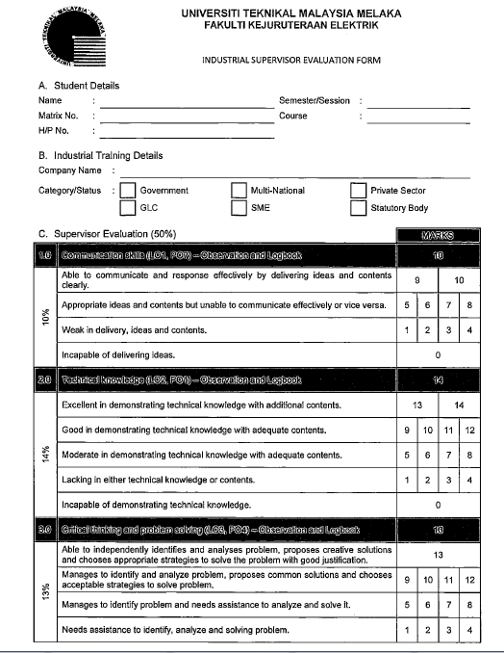
LATIHAN INDUSTRI
Example of Rubrics

Slide 114
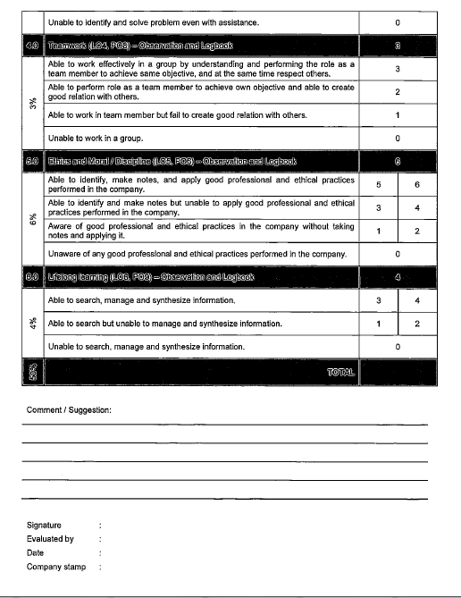
LATIHAN INDUSTRI
Example of Rubrics

Slide 115
Faedah Penskoran Rubrik
Ketekalan pengkadaran (ratings)
  Antara pelajar
  Antara penilai
Mengurangkan ralat pengkadaran
  Halo effect
  Central tendency errors
  Rater drift

Slide 116
Faedah Rubric
Menjadikan penskoran lebih mudah dan lebih cepat
Berguna sebagai alat pembelajaran
  Jangkaan lebih jelas kepada pelajar
  Menyediakan maklum balas yang berguna dan terperinci kepada pelajar
Berguna sebagai panduan mengajar
  Fokus kepada pembelajaran pelajar

Slide 117
Bagaimana membina rubrik penskoran?
Tentukan hasil yang akan ditaksir
Putuskan sama ada penskoran holistik atau analitik yang lebih sesuai
Pilih bilangan tahap prestasi (3 hingga 5)
Kenal pasti standard prestasi (performance standard) (contoh, >3)
Bentuk matriks
Lengkapkan setiap sel dalam matriks
  Mulakan dengan tahap tinggi (excellent/poor; acceptable/unacceptable)

Slide 118
Bagaimana membina…
Kajian rintis dan semak semula;
Kongsi rubrik penskoran dengan pelajar;
Gunakan rubrik penskoran;
Latih penilai, kemudian periksa kebolehpercayaan penilai;
Sediakan maklum balas kepada pelajar.

Slide 119

REFLECTIVE TECHNIQUE
Really hearing and understanding what the other person is saying through words and body language, and
Reflecting feelings and thoughts you heard through your own words, tone-of-voice, body posture and gesture so that the other person knows he or she is understood.

Slide 120

Reflective Clusters
Skill Cluster | Specific Skills
1. Attending Skills | Contact Posture Gestures Environment
2. Following Skills | Door-Openers Acknowledgment Responses Active Silence Open-ended Questions
3. Responding Skills | Paraphrasing Reflecting Feelings Reflecting Meanings Summarizing

Slide 121
ATTENDING SKILLS
Attending is giving physical and psychological attention to another in a communication situation. Effective attending conveys non-verbally that the listener is interested and is paying careful attention to the other - that the listener cares!
FOLLOWING SKILLS - DOOR-OPENERS
A door-opener is a non-coercive invitation extended to another to talk--an invitation to get started, to say something about what he or she is thinking or feeling. Some examples of door-openers are:
  Would you like to talk about it?
  Can I be of any help with this problem?
  I’d be interested to hear how you feel.
  Would it help to talk about it?
  Sometimes it helps to get it off your chest.
  I’ve got the time if you have. Want to talk?
  Hi, Joe. You appear a little glum.
  You seem happy. I’d like to hear about it.
  Is something bothering you?

Slide 122
OPEN-ENDED QUESTIONS
An open-ended question is one which allows another to answer in any way or in any depth he or she chooses. This kind of question does not invite “yes” or “no” or a short response. Open-ended questions can assist the other in exploring aspects of himself or herself that were not initially available to the conscious mind.
Closed-ended questions, on the other hand, tend by their nature, to limit the other to short responses. Closed-ended questions usually begin with “are”, “do”, “is”, “where”, “did”, “was”, “here”, or “why”. Questions of this type probe for motives or justifications, and therefore tend to promote a defensive reaction in another. Closed-ended questions should be avoided when practicing reflective listening techniques.
Examples of some open-ended questions are:
  What are you feeling about that?
  Could you tell me some more about that?
  What’s on your mind?
  Could you give me an example?
  Could you fill me in a little more about ... ?
  Can you say some more about ... ?
  How was that for you?

Slide 123
RESPONDING SKILLS
This involves listening accurately to another person and reflecting the main points of the other’s communication in a concreter, brief, and concise manner.
  Paraphrasing -the act of saying back to the speaker your own words what you heard the person say. Could paraphrase content or meaning.
  Reflective Feelings - listening accurately to another person and reflecting the emotional state of the person in your own words.
  Reflecting Meanings - listening accurately and reflecting both the content and the feeling of the other. The reflecting meanings and feelings are ways to check your perception of the speaker so that s/he feels connected with you: Some examples:
    I wonder if ...
    It seems to me that you’re saying / might be feeling ...
    I get the impression that ...

Slide 124


